Slide 1
A Neuroscience Approach to Social Status Perception and Health
Bradley D. Mattan, Ph.D.
Annenberg School for Communication
University of Pennsylvania

Slide 2
A Neuroscience Approach to Social Status Perception and Health
Bradley D. Mattan, Ph.D.
Annenberg School for Communication
University of Pennsylvania
Notes:
[CHECK MIC IS UP]
[THANK PERSON WHO INTRODUCES ME.]
Before I get started, you may have noticed that I am using subtitles for this presentation.
* In addition to their benefit for people with hearing impairments, subtitles can also be helpful in the current moment where we find ourselves working from home with spotty internet connections and occasional distractions from household members.
* Now, if you do find that the subtitles to be a distraction, some find it helpful to put a book or two in front of the monitor to block them out.
* Alright. Without further ado, I’d like to start by thanking the search committee at Louisiana State University for this opportunity to share my work with you.

Slide 3
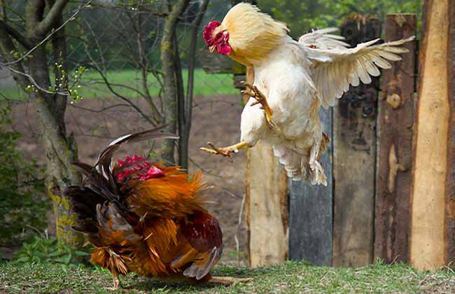
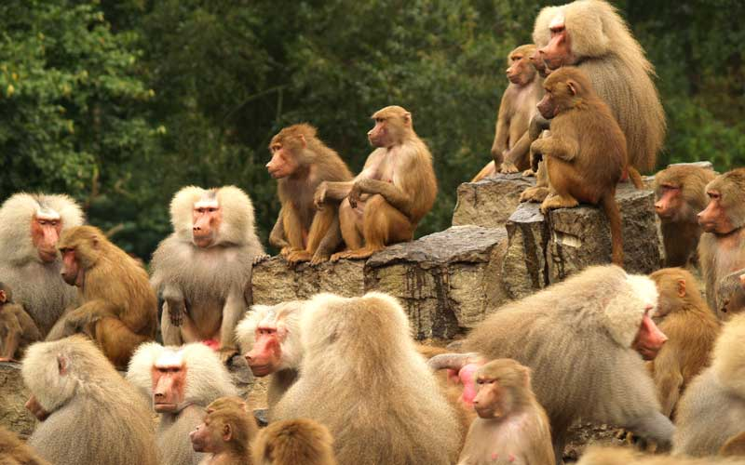
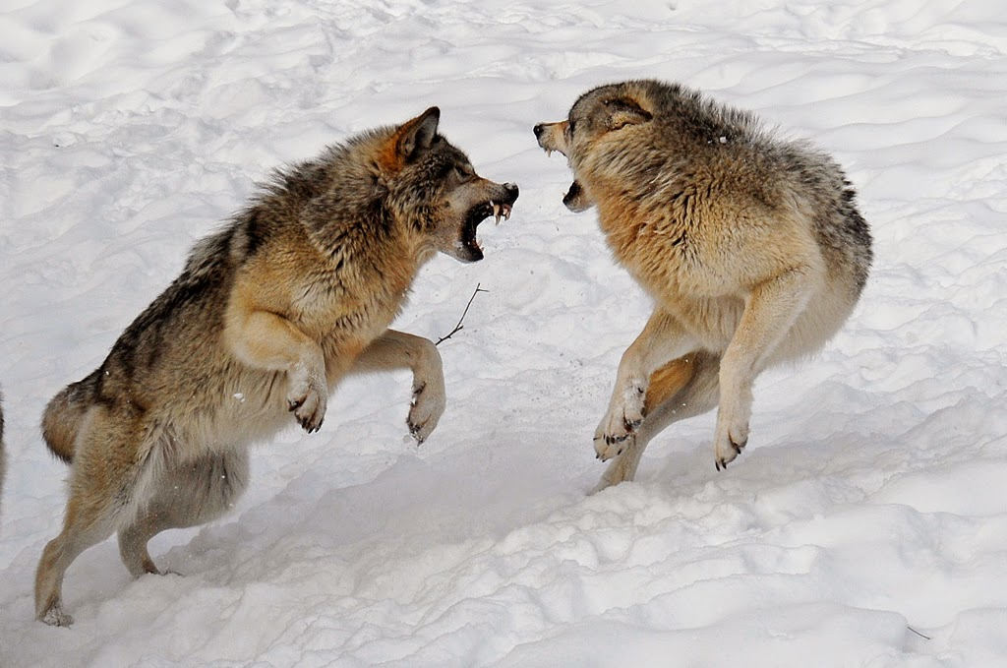
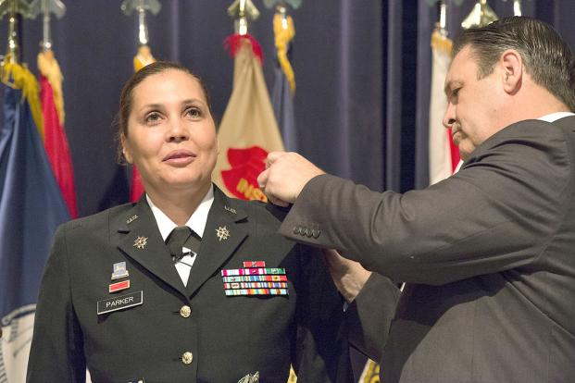
Social hierarchy in the animal kingdom
Notes:
As a social neuroscientist, I study how we detect where people are in a social hierarchy (what I call their social status) and what this means for how much we like them and/or pay attention to them. If you look at the animal kingdom, you’ll notice that hierarchies are endemic. (CLICK) From pecking orders in chickens to the hierarchical structures of wolf packs and baboon troops (CLICK), status differences seem to dictate interactions between animals in ways that frequently benefit the health of those at the top. Humans are no exception. (CLICK) We exist in multiple intersecting hierarchies that have different consequences for social evaluations and health.

Slide 4
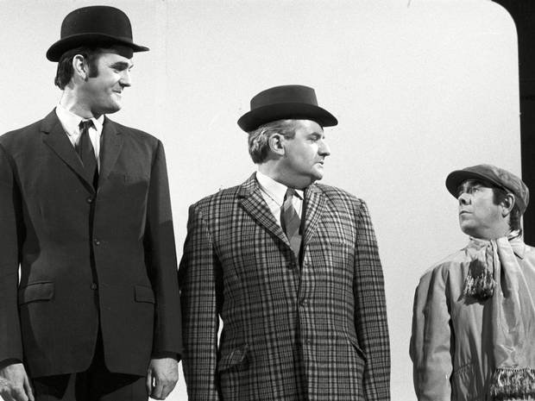

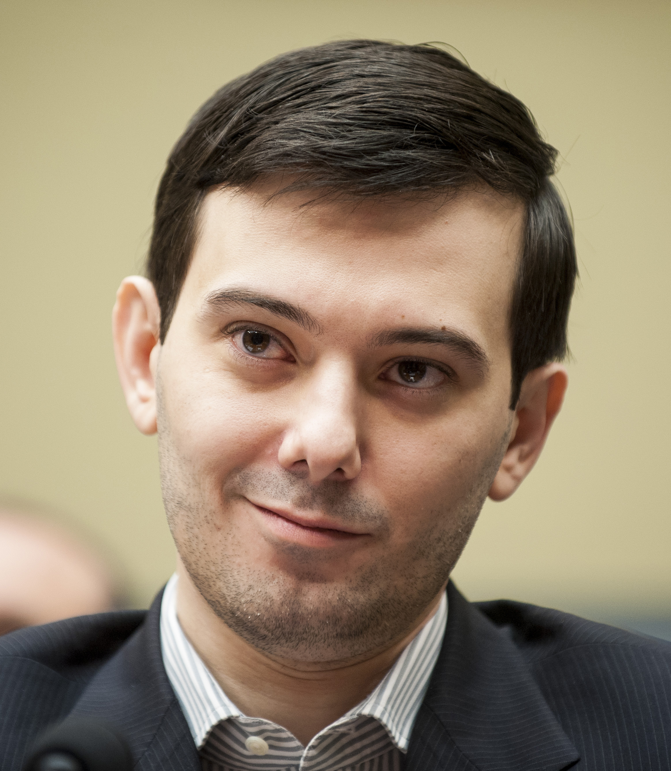

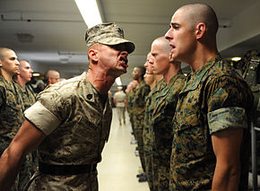
What is status?
Relative rank of an individual along one or more socially valued dimensions
Mattan et al., 2017, Persp. on Psych. Sci.
Notes:
Before I go any farther, I want to take a moment to define what I mean by status, because people can define it in many ways.
(CLICK) I define status as…
* You’ll notice that here I’m not necessarily tying status to a particular dimension like income or education.
(CLICK) Certainly, there is the tradition in neuroscience of focusing on socioeconomic status, which is a composite of income, education, and occupation. However, there are other ways we can rank people that meaningfully shape social interactions and health.
* Some other potentially relevant but underexplored dimensions of social rank include… (CLICK AND DESCRIBE)
* Depending on the context, one or more of these dimensions may serve as the primary basis for social hierarchy, and the health consequences of being high or low in status on each of these dimensions may not always be the same.
* For example, some research suggests that education may be more strongly associated with risk factors for cardiovascular disease, but family income may have a greater influence on brain development.
****************************************************************************
Education matters more than income for CVD:
Winkleby, M. A., Jatulis, D. E., Frank, E., & Fortmann, S. P. (1992). Socioeconomic status and health: how education, income, and occupation contribute to risk factors for cardiovascular disease. American journal of public health, 82(6), 816-820.
Income matters more than education for cortical surface area, which mediated certain neurocognitive abilities:
Noble, K. G., Houston, S. M., Brito, N. H., Bartsch, H., Kan, E., Kuperman, J. M., ... & Schork, N. J. (2015). Family income, parental education and brain structure in children and adolescents. Nature neuroscience, 18(5), 773-778.

Slide 5
An intersectional approach
Stereotypic links with race (Moore-Berg & Karpinski, 2018) and gender (Ridgeway, 2006)
These links shape evaluative biases for:
Race (Mattan et al., 2018, SCAN; Mattan et al., 2018, eNeuro; Mattan et al., 2019, PSPB)
Gender (Mattan & Cloutier, 2020, Royal Soc. Open Sci.; Barth, Mattan, et al., 2020, Scientific Reports)
Status associations predict intergroup hierarchy maintenance (Dupree et al., 2020)
Mattan et al., 2018, Current Opinion in Psychology.
Notes:
Although not typically considered as status dimensions in the same sense as the attributes I just covered, social categories like race and gender are stereotypically linked to status. Until recently, however, neuroscience and some areas of psychology have tended to approach socioeconomic status independently of these social constructs.
(CLICK) As part of a growing trend in neuroscience and psychology that considers status in the context of intersecting social identities, my published work uses implicit and neuroimaging measures to examine the biased ways we evaluate people at the intersection of status and social constructs like race.
(CLICK) These biases are important considering work by others that has shown that they can lead to decisions that reinforce social inequity, which has implications for the economic, physical, and psychological well being of people with multiple disadvantaged identities.

Slide 6
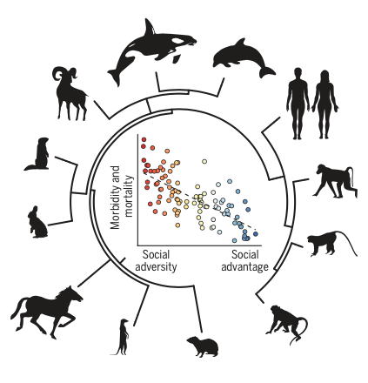
Status-health gradient (Adler et al., 1994)
Snyder-Mackler, et al., 2020
Notes:
In my research, I am interested in the interplay between social status, stress, and health-related behavior as it contributes to socioeconomic disparities in health.
(CLICK) Like our distant relatives throughout the animal kingdom, evidence consistently shows a status-health gradient. In a review from Prof. Tung’s group at Duke that came out this year in Science, they illustrate this gradient nicely, showing that individuals closer to the top of social hierarchies (on the x axis) tend to have lower morbidity and mortality (on the y axis).
*****************************
Buckner looks at manipulated discrimination on smoking in Black smokers

Slide 7
Neuroscience of status and health
Social Psychology
& Neuroscience
Implicit prejudice
Mattan et al., 2019
Mattan & Cloutier, 2020
Barth et al., in prep.
Impression formation
Mattan et al., 2018a
Mattan et al., 2018b
Dang, Mattan* et al., 2019
Barth, Mattan*, et al., 2020
Decision making
Mattan et al., 2020
Mattan et al., in prep.
Social Determinants
of Health Disparities
Race-related stressors
Johnson et al., under review
Poverty and smoking
Mattan et al., in prep.
Status and immunity
Health Psychology
& Neuroscience
Physical activity
Mattan et al. in prep.
Tobacco retailers
Mattan et al., ongoing
Andrews et al., in prep.
COVID-19 messaging
Mattan et al., in prep.
Andrews et al., in prep.
Pei et al., under review
* Shared first author
Notes:
Now, the status-health gradient is a macro-level phenomenon. In order to intervene, it is important to understand how the accumulation of micro-level effects ultimately contributes to health disparities. To do this, I plan to draw on my research and expertise in social neuroscience and health neuroscience.
* I won’t have time to cover the full breadth of my research today, so I will give you a brief overview of the scope of my work before focusing in on a few studies.
(CLICK) In my work on social psychology and neuroscience, I have studied: (CLICK x3)
(CLICK) In my more recent second line of work in health psychology and neuroscience, I am interested in: (CLICK x3)
(CLICK) Finally, my main focus going forward will be to apply the tools of neuroscience and psychology to understand how status differences and social comparisons negatively impact well-being. In this vein, I am interested in (CLICK x2).
(CLICK) However, in the future, I am also plan to explore how our experience of social hierarchy relates to our immune system functioning.

Slide 8
Neuroscience of status and health
Social Psychology
& Neuroscience
Implicit prejudice
Mattan et al., 2019
Mattan & Cloutier, 2020
Barth et al., in prep.
Impression formation
Mattan et al., 2018a
Mattan et al., 2018b
Dang, Mattan* et al., 2019
Barth, Mattan*, et al., 2020
Decision making
Mattan et al., 2020
Mattan et al., in prep.
Social Determinants
of Health Disparities
Race-related stressors
Johnson et al., under review
Poverty and smoking
Mattan et al., in prep.
Status and immunity
Health Psychology
& Neuroscience
Physical activity
Mattan et al. in prep.
Tobacco retailers
Mattan et al., ongoing
Andrews et al., in prep.
COVID-19 messaging
Mattan et al., in prep.
Andrews et al., in prep.
Pei et al., under review
* Shared first author
Notes:
In my talk today, I am going to present first my fMRI work on status-based impression formation, with a focus on how perceived status intersects with social identities such as race and gender.
(CLICK) After that, I will touch on some more recent work that uses fMRI to predict the way that people will respond to health messaging that promotes physical activity.

Slide 9
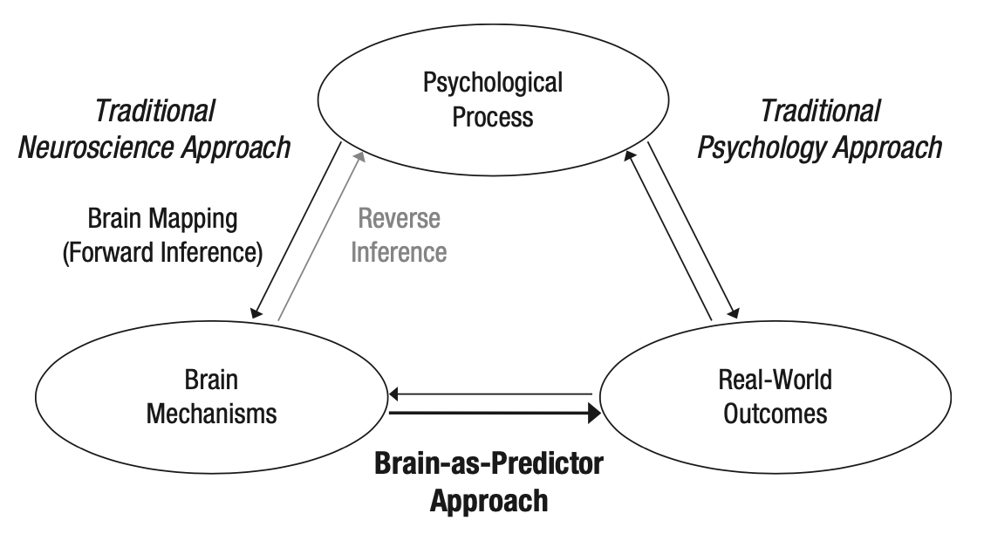
Neuroscience approaches
Berkman & Falk, 2013
Notes:
In my efforts to understand the relationships between social status and health, I want to highlight the different ways that I use neuroimaging.
(CLICK) In the impression formation work I will show you first, I take a brain mapping approach to identify neural responses to impression formation and how these are modulated by perceived status and the perceiver’s motivation to respond without prejudice.
* In the work on health messaging that I will show you, I use a mapping approach to identify patterns of brain activity that reflect decisions about the self-relevance and valence of trait words.
(CLICK) However, I also use a brain-as-predictor approach to understand how these patterns of brain activity predict real-world outcomes, in this case people’s receptivity to health messaging.
* This brain-as-predictor approach is important to my future directions, so I will return to it later in my talk.

Slide 10
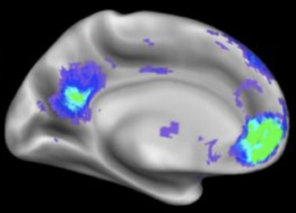
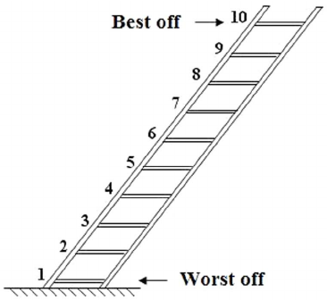
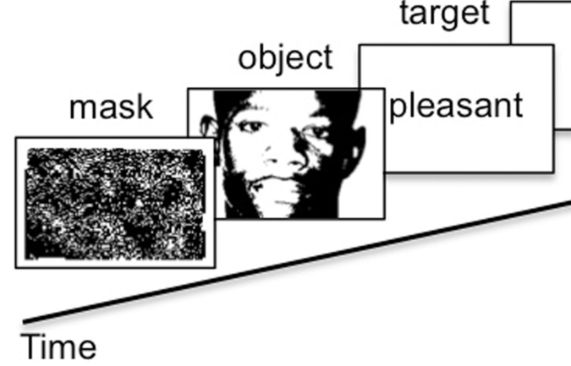
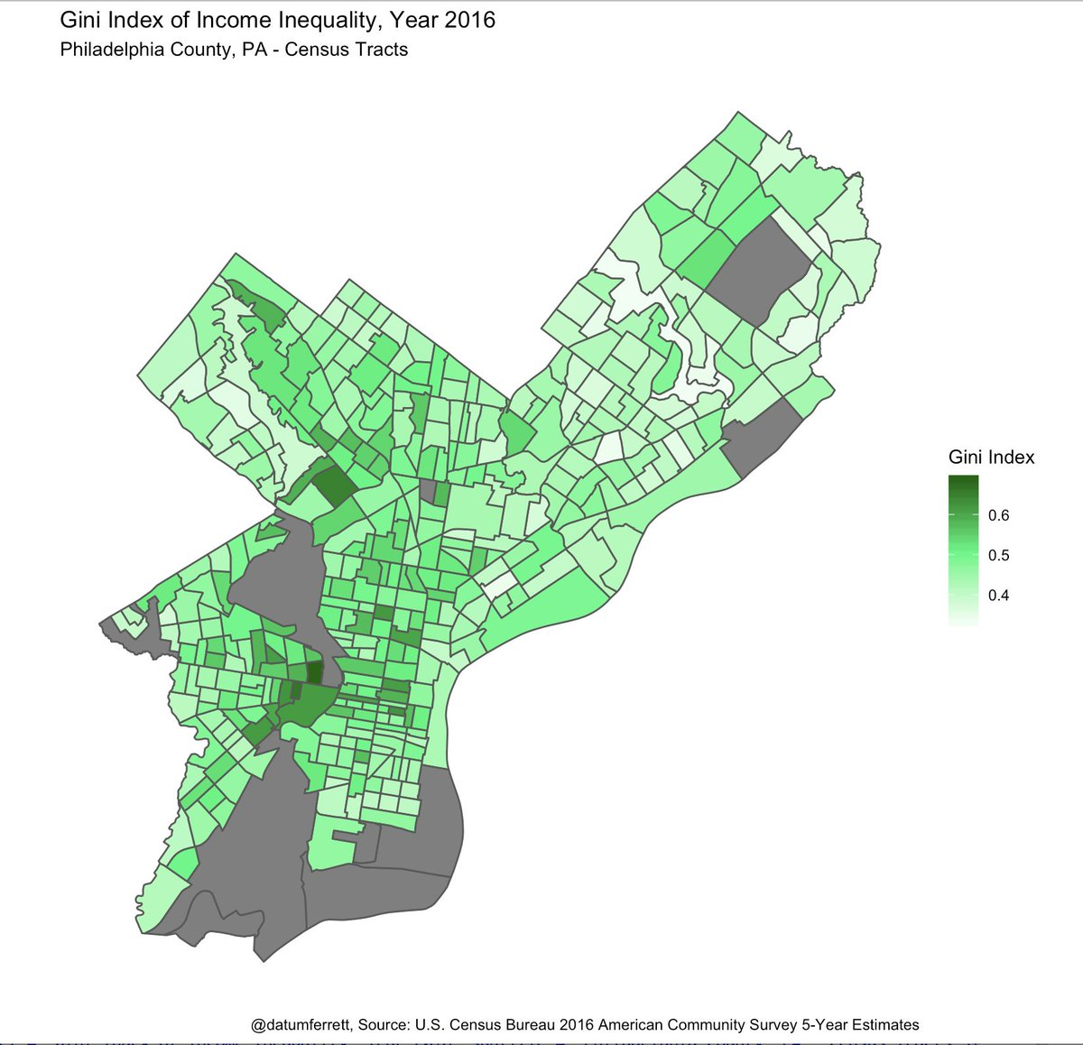
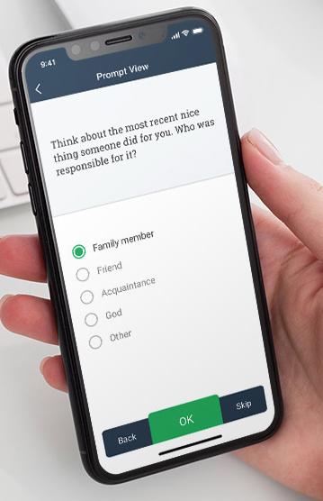

Multi-level approach
target
prime
mask
Evaluative Priming Task
time
MacArthur Ladder: Subjective Status
Notes:
* Complementing my use of fMRI, I want to highlight that I approach status and health from multiple levels, looking at implicit and explicit behavioral responses (CLICK), geolocation data (CLICK), ecological momentary assessments (CLICK), and health-related behaviors (CLICK).
(PAUSE)
************************************************
One of the advantages of these methods is that they allow me to look at the health consequences of both the perceiver’s status and of status as it is perceived in other people and places. When it comes to my work on the social determinants of health, the contributions of the participant’s self-reported status and their status as they are perceived by others is important.

Slide 11
Overview
What neural processes support impression formation based on perceived status and race?
Can we isolate neural signatures of self-relevance and valence to predict health message effectiveness?
Future directions
Notes:
In this presentation, I’ll talk with you first about some of my work on neural responses to perceived social status and race during impression formation. In discussing this work, I will focus on the implications of these findings for interracial interactions and the well-being of racialized people.
* I will also touch on some work on how gender shapes status-based impression formation.
(CLICK) Next, I will present some of my recent work that focuses on how neural responses to self-relevance and valence can predict the effectiveness of health messaging.
(CLICK) Finally, I will conclude by articulating a research program that will wed my work in social and health neuroscience in a way that will generate new insights into the mechanisms underlying the status-health gradient.
(CLICK) So, with this bigger picture in mind, let’s start with the first research question.

Slide 12
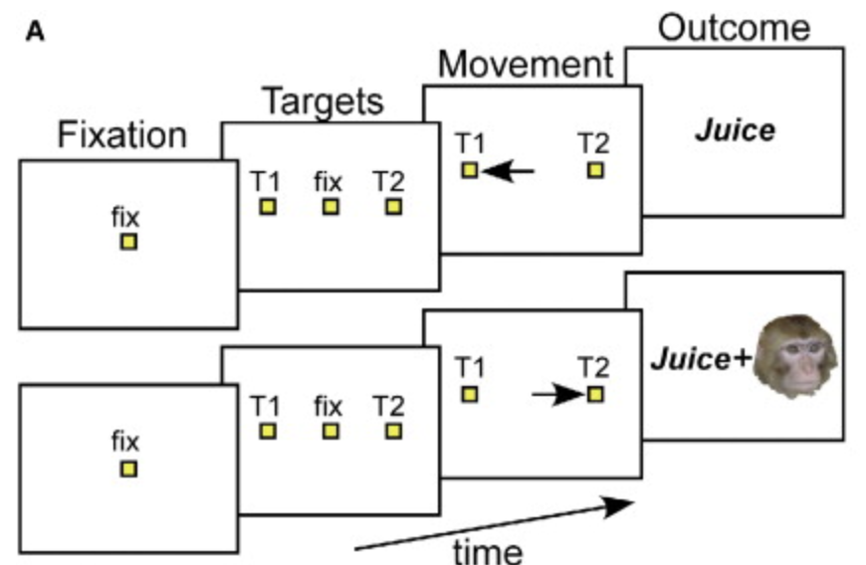
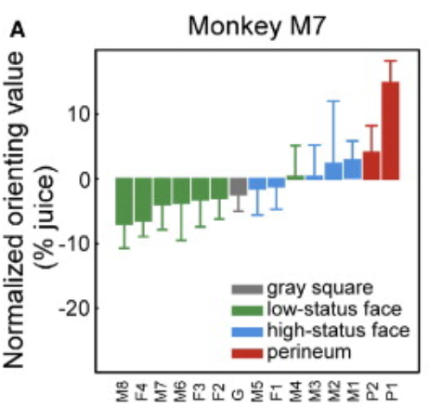
The value of seeing high status
Deaner et al., 2005
Mattan et al., 2017, Persp. on Psych. Sci.
Notes:
To begin, I want to highlight the psychological and neural mechanisms that I think are at play. In my 2017 social neuroscience framework for status perception, I start with the idea that seeing high-status people is a rewarding experience.
(CLICK) I’ll give you one illustrative example of this from the non-human primate literature before covering some of my work with human participants. In a provocative piece in Current Biology, Robert Deaner and colleagues trained rhesus macaques to use their gaze to choose between receiving different amounts of juice.The catch was that one of the juice options would also come with the opportunity to view a high-status face or a low-status face.
(CLICK) It turns out that the macaques were more willing to forgo the option that option that yields more juice if the other option was paired with a high-status face. Conversely, they required a large juice payout differential in order to choose the option paired with a low-status face.
* Given that paying attention to higher ranked individuals is relevant to survival and well-being in a hierarchical species, this finding makes some sense.
****************************************************************************************
I also looked at
Nucleus accumbens: reward/salience responses
Amygdala: detection of threat and/or personal relevance.

Slide 13
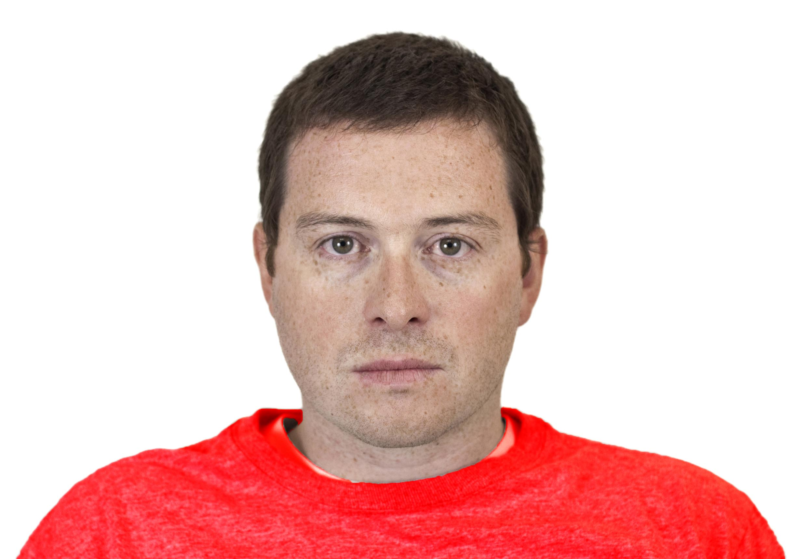
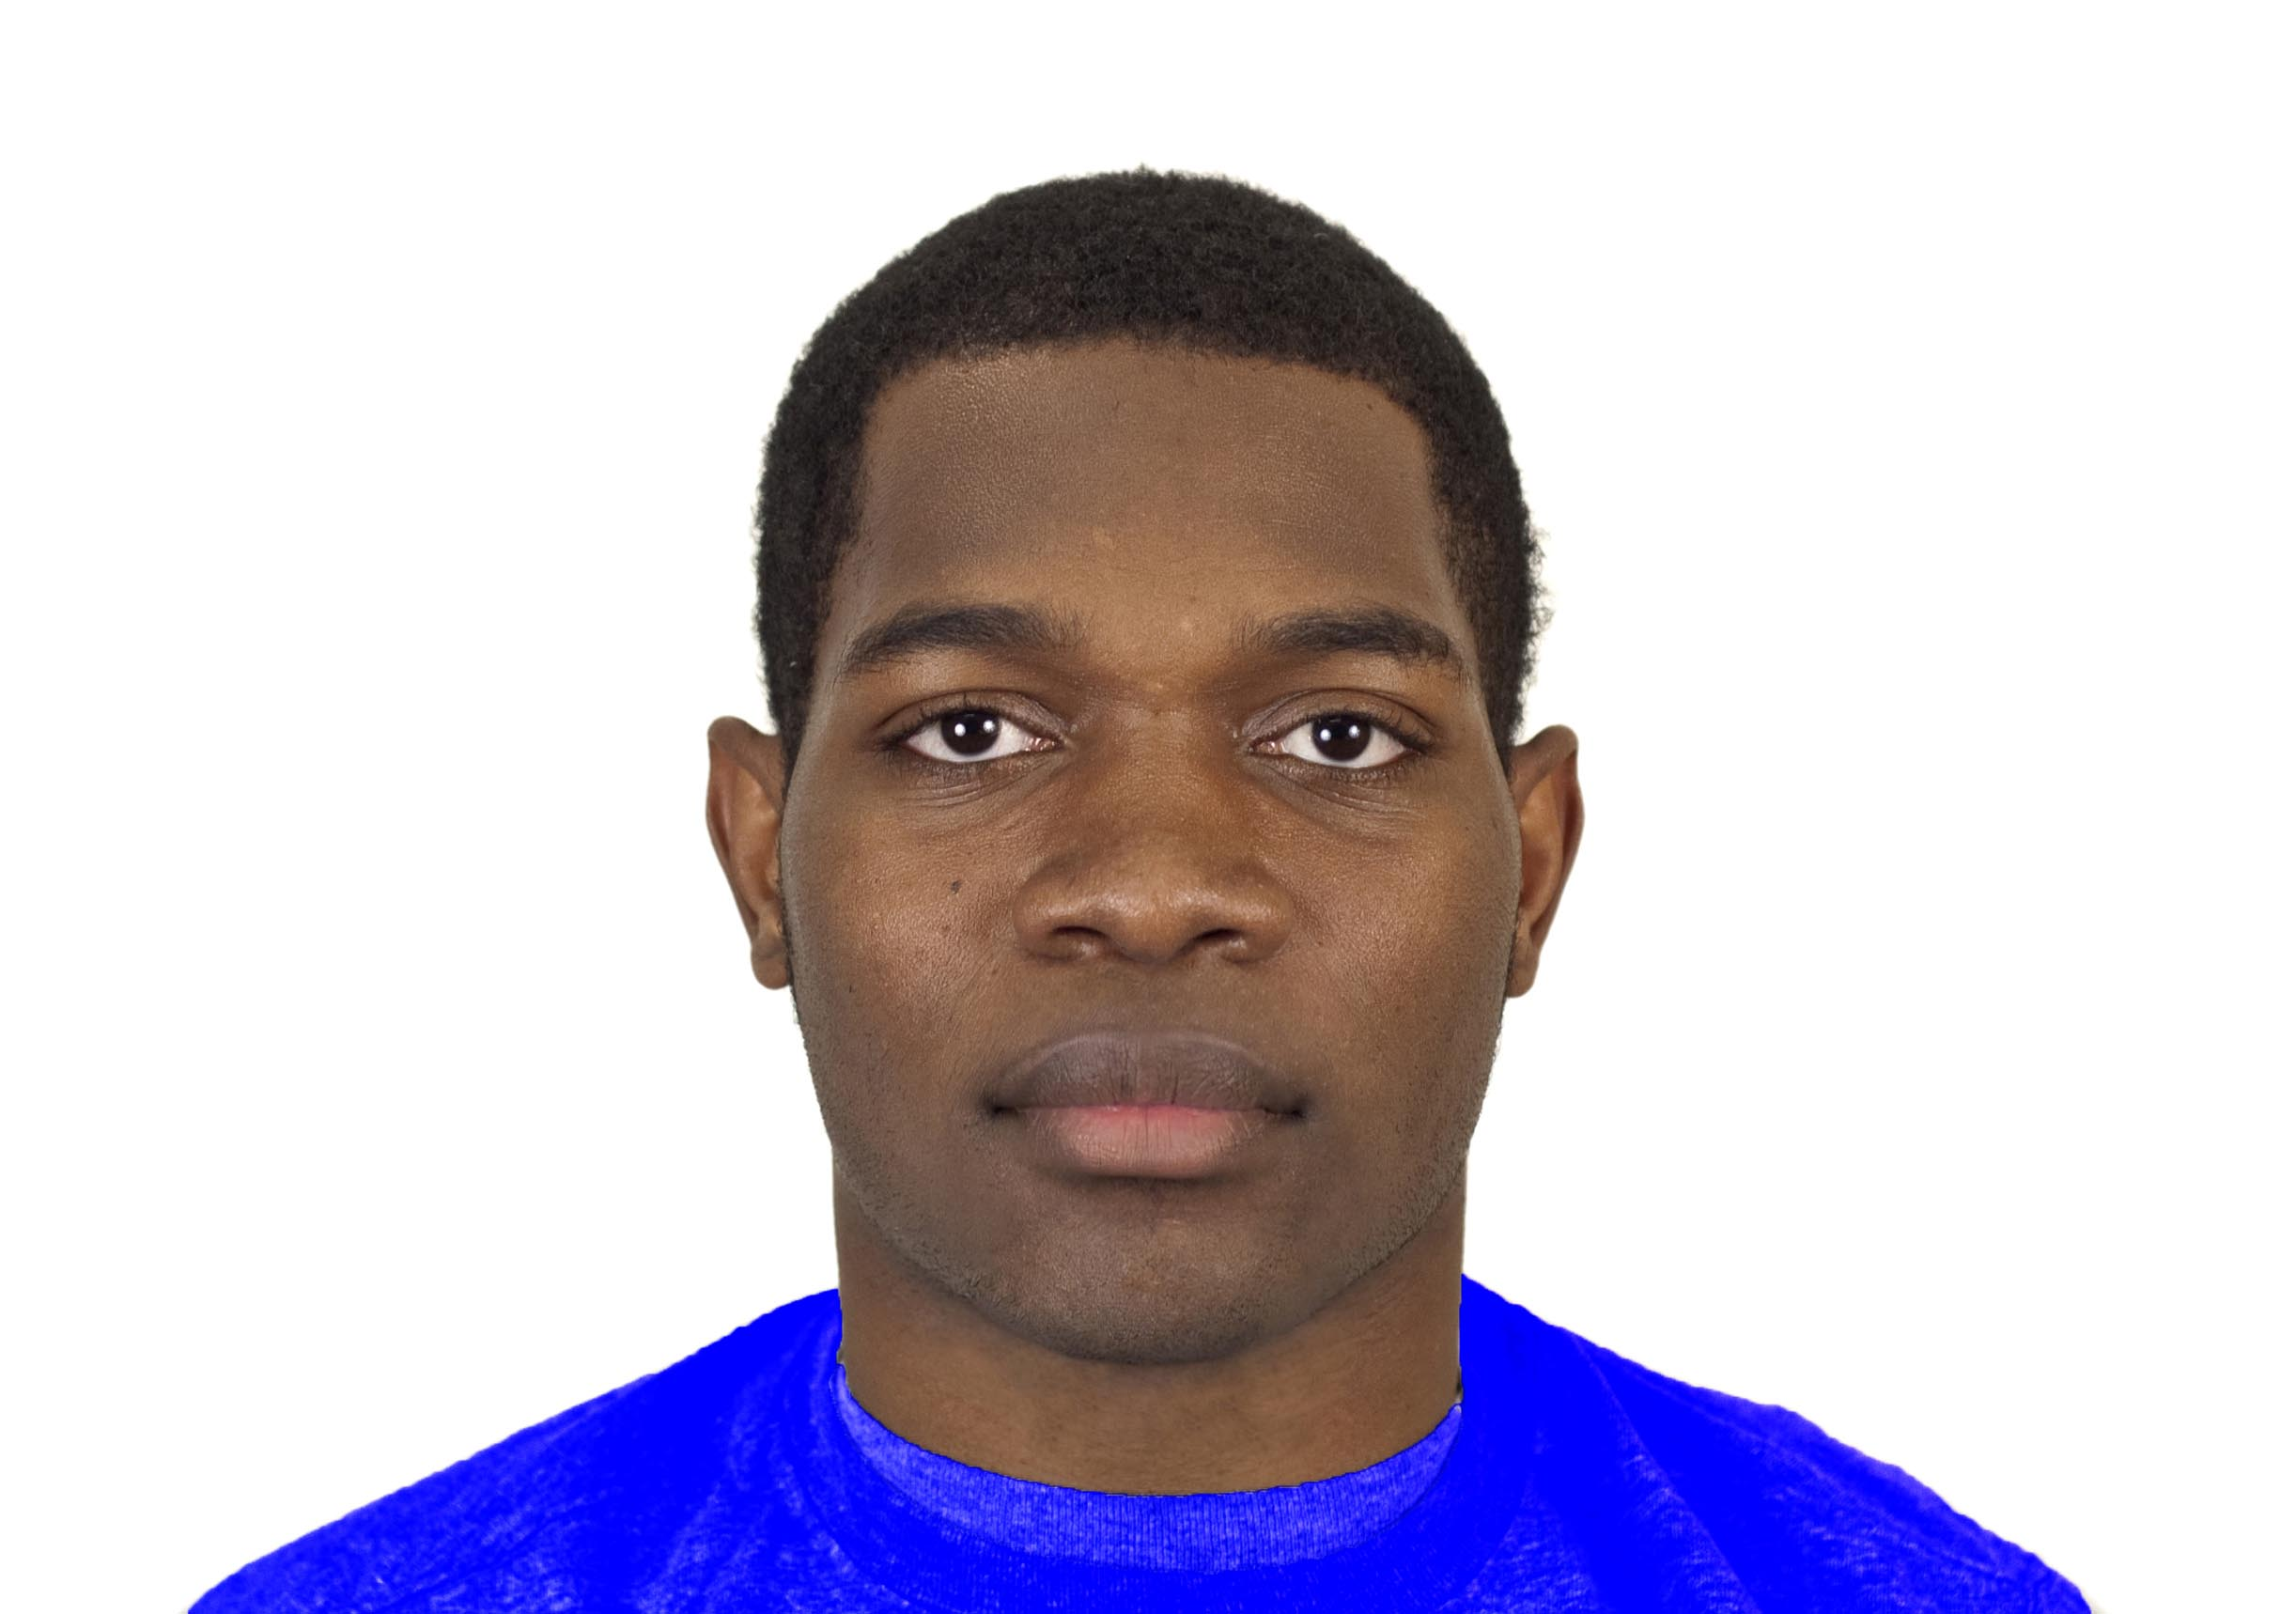
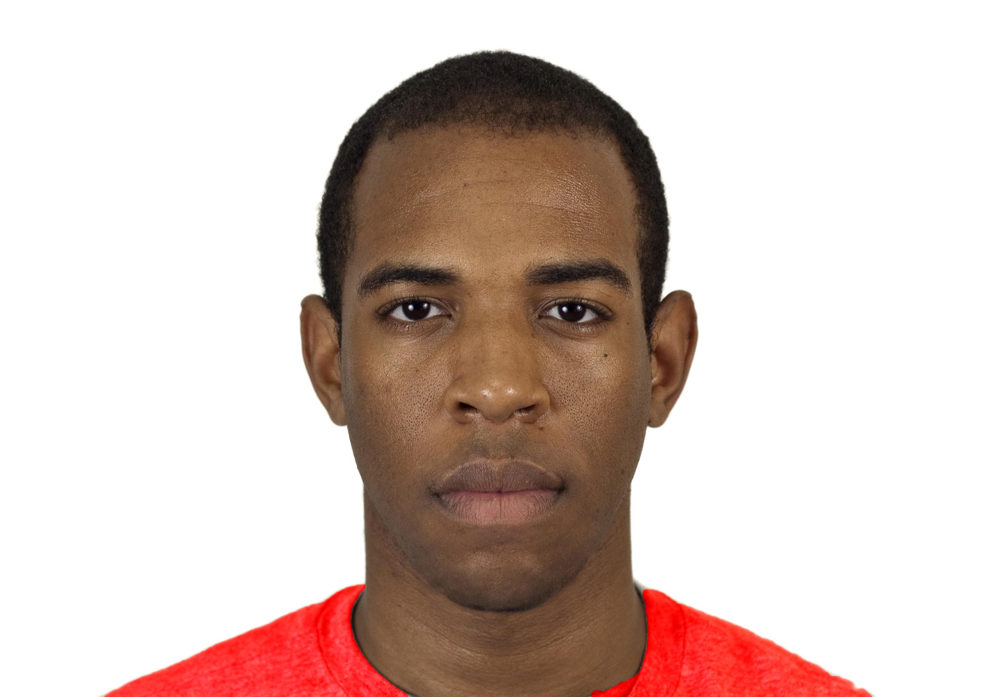
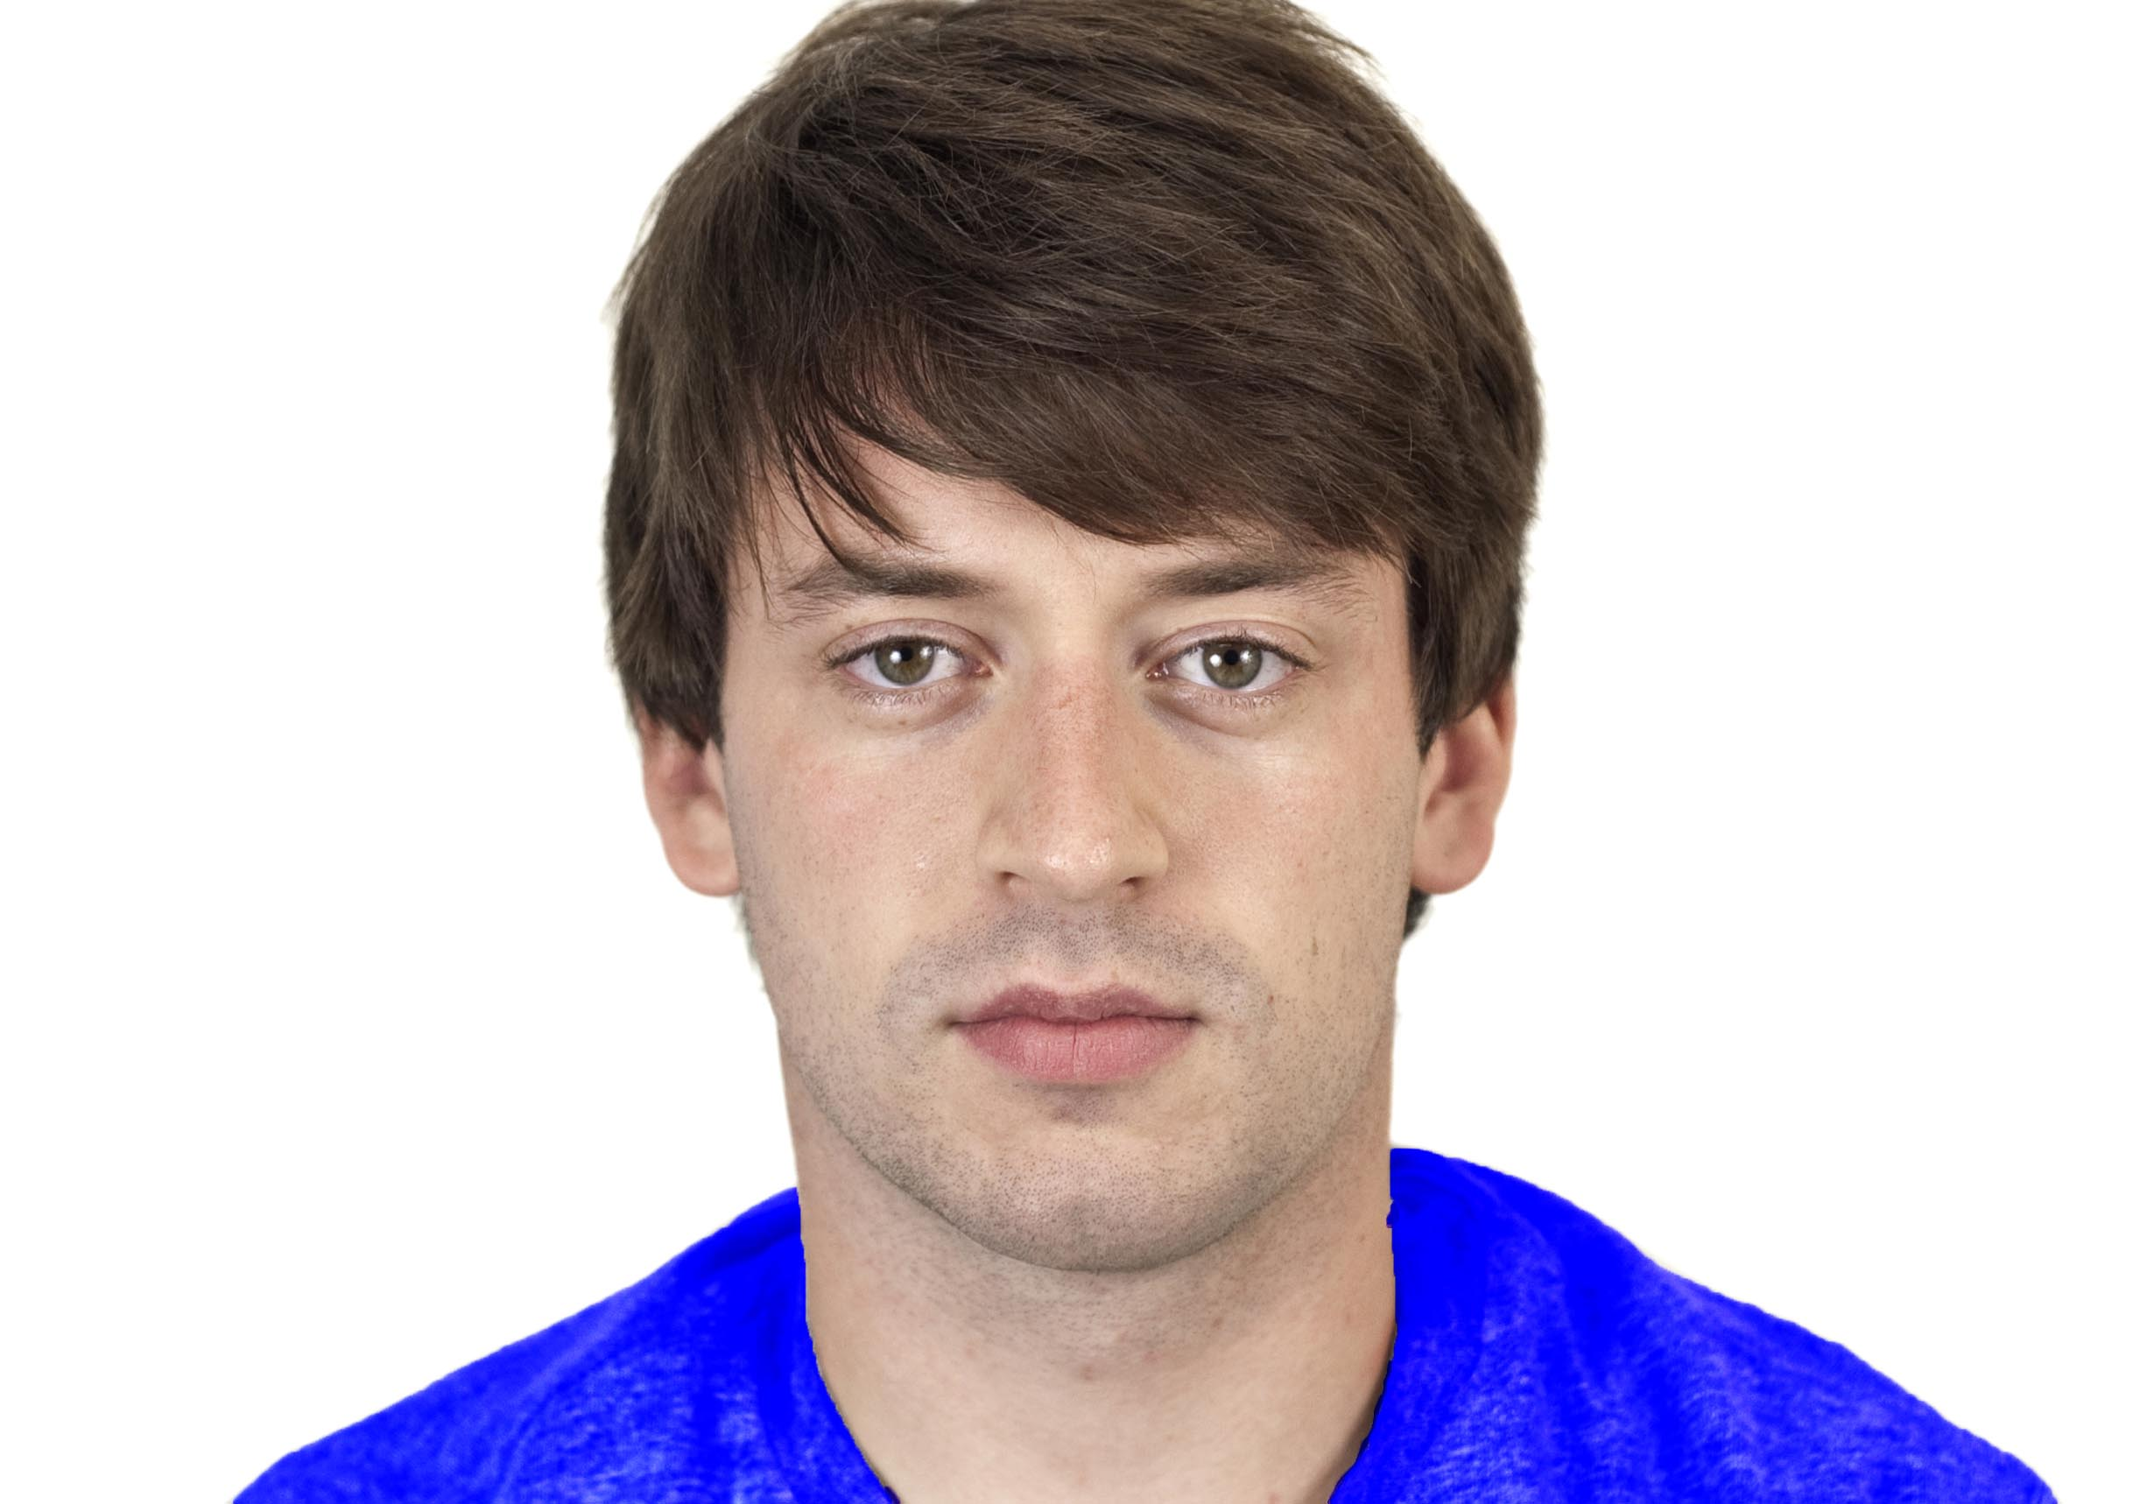
Status-based evaluation in humans
Explicit evaluations favor high status, but are context sensitive (Cuddy et al., 2008; Horwitz & Dovidio, 2017; Rudman et al., 2002; Varnum, 2013)
High status favored at implicit level
Evaluative priming (Mattan et al., 2019, PSPB)
Affect misattribution (Boukarras et al., 2019)
IAT (Mattan & Cloutier, 2020, Royal Soc. Open Sci.)
High Status
Low Status
Mattan et al., 2017, Persp. on Psych. Sci.
Notes:
Recent work has begun to illustrate that, like rhesus macaques, we also tend to value high status positively.
(CLICK) When you directly ask people what they think about low- and high-status people, these explicit evaluations frequently favor high-status over low-status people. One exception to this comes from work that uses the warmth-competence framing of the stereotype content model. In these studies, high-status people are frequently rated as cold but competent.
(CLICK) Research on implicit bias also shows that high-status people are often associated with positive valence. This has been shown using a range of classic paradigms, including… (CLICK x3)
…all of which show positive associations favoring high status when it is defined in terms of socioeconomic status or competence.
(CLICK) This is not universally the case though. I’ve found for example that biases favoring high status may be less reliable in women compared to men.
(CLICK) Relevant to my neuroimaging work I will show you next, my recent paper in PSPB showed that implicit bias favoring high-status people benefits White people more than Black people.
**********************************************
(CLICK) In one study, participants showed a halo effect for high social class, reporting that social class correlates with a range of positive personality traits. (Varnum, 2013)
(CLICK) However, in studies that focus on warmth and competence, people report ambivalent views about high-status people, rating them as competent but cold. (e.g., Cuddy et al., 2008)
(CLICK) Other studies also show evidence of explicit ingroup favoritism along class lines. (Horwitz & Dovidio, 2017; Rudman et al., 2002)

Slide 14
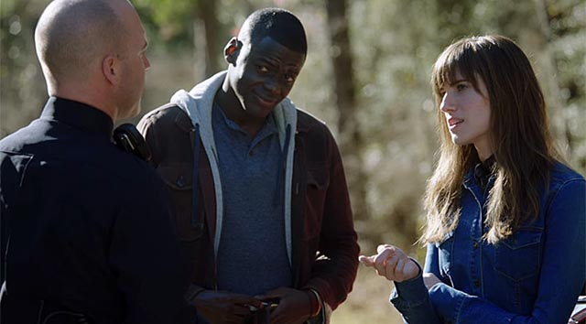

Deliberate impression formation
Notes:
In my neuroimaging work, I aim to understand what people might do to regulate these biases when they have the time to form an impression.
* This is important because, in everyday life, we often encounter people in contexts that allow us to take our time evaluating them.
* For White people, this might mean being mindful of regulating implicit associations favoring high-status White people that I just mentioned.
* For racialized people, this might mean inferring whether White people are merely regulating their bias due to external concerns about appearing prejudiced or if they do so out of a genuine concern for equity and inclusion. The answer to this question has important consequences for the success of interracial interactions and the well-being of racialized people

Slide 15
How do status and race shape deliberative impression formation?
Notes:
In the following experiment, I ask what happens when people take the time to deliberately form an impression of individuals varying in status and race?
Specifically, what are the neural processes that underlie impression formation based on social status and race. Do they overlap? Is there divergence? If so, what does it tell us?

Slide 16
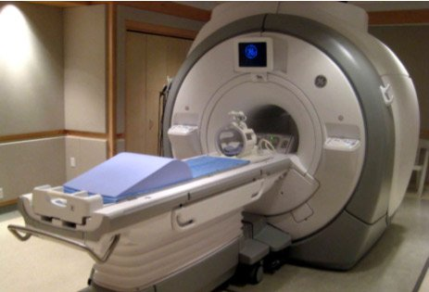
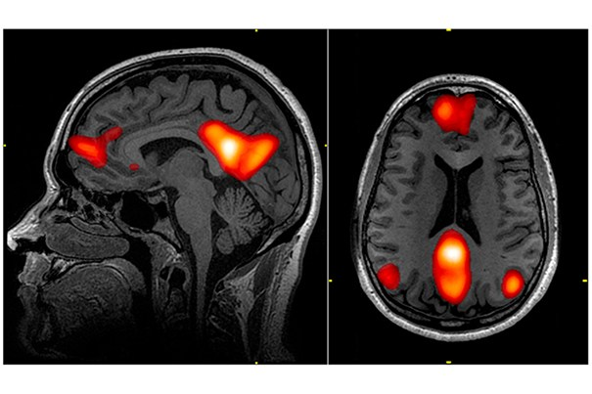
Neuroimaging approach
Offers novel insights into psychological mechanisms
Helps circumvent demand characteristics
Mattan, Kubota, & Cloutier, 2017, Persp. on Psych. Sci.
Notes:
In this work, I use fMRI to measure blood oxygenation levels as an index of metabolic brain activity while participants formed impressions of faces varying in status and race.
* I talk about this in greater detail in my review paper, but there are several benefits to using fMRI and other neuroimaging methods.
(CLICK) First of all, fMRI gives us some insight into brain regions active at rest or during different psychological processes. If we have a good sense of what processes those regions generally support, we may be able to develop new hypotheses about underlying psychological mechanisms.
(CLICK) Second, neuroimaging methods like fMRI give researchers one means of minimizing socially desirable responding.
* Generally, but not always, participants are reluctant to respond in a deliberately prejudiced fashion even if this may reflect their true beliefs on status and race.
* Using fMRI in the present study, I was able to measure neural sensitivity to status and race during deliberative evaluations without requiring participants to reveal any potentially biased responses.

Slide 17
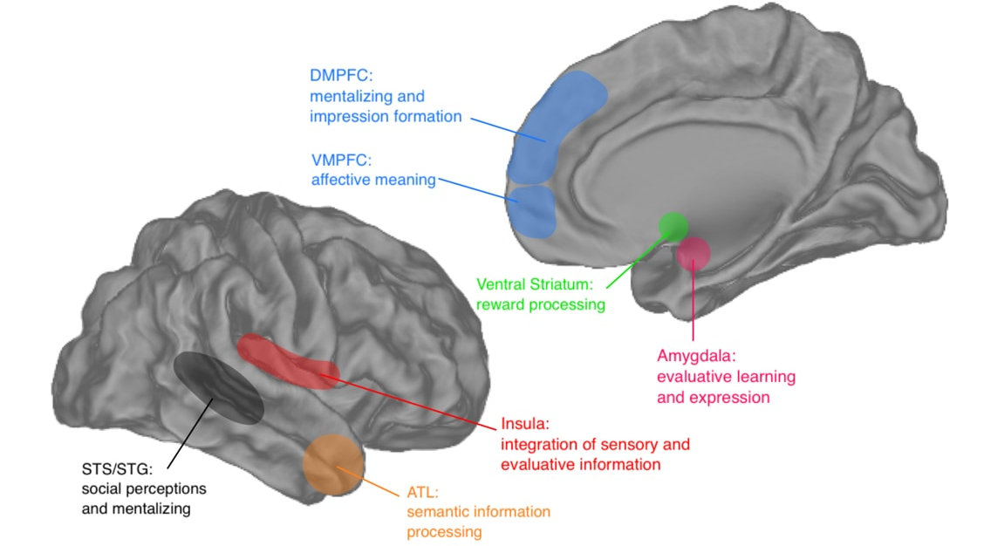
Neural substrates of prejudice
Mattan, Wei, Cloutier, & Kubota, 2018, Curr. Op. in Psych.
Notes:
In a review on the neural bases of prejudice for both status and race, I highlight that cortical midline and striatal regions are implicated in evaluations based on both attributes.
(CLICK) For the work I’ll be presenting today, I’m going to be focusing in on the ventromedial prefrontal cortex or VMPFC and the ventral striatum.
*Broadly speaking, these regions are involved in the computation of the value of people and objects.
*In this study, I looked at how the VMPFC and the ventral striatum would respond to perceived status and race during impression formation.
*I also looked at responses in the amygdala if people want to hear more about that region later.
****************************************************************************************
I also looked at
Nucleus accumbens: reward/salience responses
Amygdala: detection of threat and/or personal relevance.

Slide 18


Impression formation study
“Those who have the HIGHEST social status tend to have the most money, the most education, and the most respected jobs.”
“Those who have the LOWEST social status tend to have the least money, the least education, and the least respected jobs (or no job).”
Mattan, Kubota, Dang, & Cloutier, 2018, SCAN
Notes:
Before completing the main impression formation task, participants were given the following definitions of low and high social status, which I defined in terms of socioeconomic status or SES.
(CLICK THEN READ x 2)
*For each of these definitions, I trained participants to associate knowledge about SES levels with red and blue colored backgrounds.
(EXPLAIN COUNTERBALANCING, THEN CONTINUE)

Slide 19
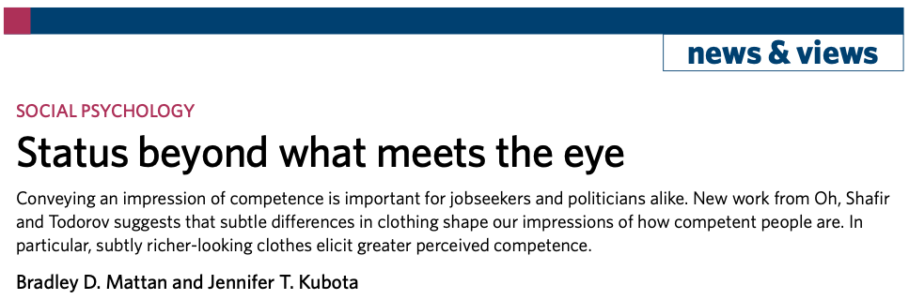

Mattan & Kubota, 2020, Nat. Hum. Behav.
Notes:
Now, perhaps you may be wondering why I did not use formal versus informal clothing as a proxy for SES.
*Recent work from DongWon Oh and colleagues demonstrates that status cues based on clothing are confounded with evaluation-relevant dimensions such as attractiveness and competence.
*In an invited commentary on this work, I argue that we need to operationalize social status more carefully in empirical work.
*In the study I am about to show you (and other studies), I used colors to ascribe status so that I could measure evaluative impacts of perceived status without confounds from clothing cues.

Slide 20
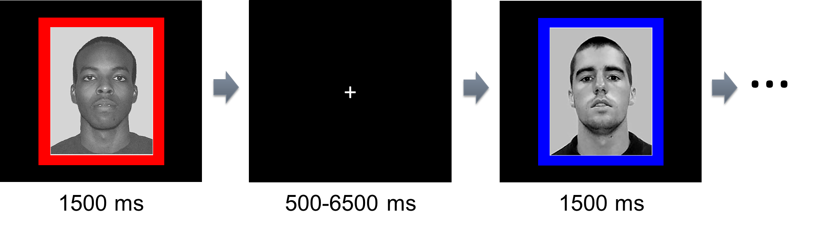
Impression formation study
fMRI impression formation task:
Mattan, Kubota, Dang, & Cloutier, 2018, SCAN
Notes:
After learning the status-color associations, participants entered the scanner and completed a standard impression formation task. Each trial consisted of a Black or White face framed by a colored background. Participants quickly formed an impression of each person, pressing one key with each index finger to indicate that they had formed their impression.
*These responses were intended to ensure the participant was engaged with the task without indicating the contents of the participants’ impressions. So evaluations were deliberative but private.

Slide 21
Individual differences in motivation to regulate bias
External motivation (Plant & Devine, 1998)
Discomfort (Amodio et al., 2006)
Effortful but inefficient self-regulation (Richeson et al., 2003)
Focus on alternative attributes/topics (Apfelbaum et al., 2008; Norton et al., 2006)
Mattan, Kubota, Dang, & Cloutier, 2018, SCAN
Notes:
Especially when it comes to racial bias, I reasoned that some participants would be more concerned than others by the possibility of their bias being somehow revealed, even during private impression formation in the scanner.
(CLICK) Regulating one’s racial bias out of a concern for what others will think is known as external motivation to respond without racial prejudice.
* This external motivation is particularly important because it has been associated with feelings and behaviors that can derail interracial interactions including… (CLICK X 3)
***In sum, I wanted to address two gaps in the literature: 1) how do status and race jointly affect impression formation, and 2) how do individual differences in external motivation influence these impressions?
* For example, would externally motivated individuals tend to use SES over race to form their impressions?
***************************************
We aimed to address two key gaps in the literature on race and status. Although previous work has found that high-EMS Whites favor the use of non-racial attributes (e.g., age, gender) over race when describing people (Apfelbaum et al., 2008), it is unclear whether and how high-EMS individuals use relatively knowledge-based attributes (e.g., SES), to inform interracial impressions. SES is particularly relevant in the context of race due to evidence of race–SES associations (Allport, 1954; Brannon & Markus, 2013; Freeman, Penner, Saperstein, Scheutz, & Ambady, 2011; Penner & Saperstein, 2008; Sanchez & Garcia, 2012; Weeks & Lupfer, 2004). Despite this evidence, few studies have explored how race and status jointly affect person evaluation (Fiske, Dupree, Nicolas, & Swencionis, 2016; Richeson & Sommers, 2016; Smedley & Bayton, 1978). Additionally, few fMRI studies have considered effects of motivation on evaluative bias (but see Li, Cardenas-Iniguez, Correll, & Cloutier, 2016; Wheeler & Fiske, 2005), and none have examined the role of EMS to our knowledge. This is surprising given the extensive behavioral and electrophysiological literature on this important motivation (Amodio, 2009; Amodio et al., 2006; Bijleveld, Scheepers, & Ellemers, 2012; Blascovich, Mendes, Hunter, Lickel, & Kowai-Bell, 2001; Mendes, Blascovich, Hunter, Lickel, & Jost, 2007; Mendes, Blascovich, Lickel, & Hunter, 2002; Page-Gould, Mendes, & Major, 2010; Page-Gould, Mendoza-Denton, & Tropp, 2008; Paolini, Hewstone, Cairns, & Voci, 2004; Plant & Devine, 2003; Trawalter, Adam, Chase-Lansdale, & Richeson, 2012). Addressing these gaps in the literature, we examine how EMS shapes neural responses during evaluations of targets varying in race and SES in key regions believed to support reward/salience (ventral striatum: VS), person evaluation (VMPFC), and threat/relevance (amygdala).

Slide 22
Assessing external motivation to respond without racial prejudice
EMS: 5-item subscale (Plant and Devine, 1998)
“Because of today's PC (politically correct) standards I try to appear nonprejudiced toward Black people”
Internal motivation (IMS): 5-item subscale
Mattan, Kubota, Dang, & Cloutier, 2018, SCAN
Notes:
I measured external motivation to respond without racial prejudice using the standard five-item subscale from Plant and Devine.
* EMS here refers to the subscale that is used to measure this construct. (READ ITEM EXAMPLE.)
(CLICK) I also assessed another form of motivation known as internal motivation. Internally motivated people regulate their racial bias out of a genuine concern for equity that is consistent with their values.
* I controlled for this motivation in my analyses, centering on the sample’s average internal motivation score, which for this sample was relatively high.
* Both measures were assessed online prior to the participant’s scan date.

Slide 23
Sample and analyses
Sample characteristics
60 White men
Chicago area
18-35 years old
Examined relationship between external motivation and neural responses to status/race
Subjective Status
External Motivation (EMS)
Mattan, Kubota, Dang, & Cloutier, 2018, SCAN
Notes:
For this study, I recruited 60 White men between 18 and 35 years old from the Chicago area. These participants were high in subjective status. You can see based on the histogram that most people rated themselves above the MacArthur ladder midpoint, which is in yellow.
(CLICK) This other histogram shows that the sample had a decent distribution of EMS scores across the full range of the scale and centered around the scale’s midpoint.
(CLICK) As a reminder, I looked at the relationship between external motivation and average responses to the perceived race and status of faces in the VMPFC and ventral striatum, which reflect value and reward.
*****************************************************
*This study used men because the stimuli were all men, which was part of our cover story about the faces being participants in this research.
*Using a linear mixed effects model with random intercepts by participant, I tested for effects of face race, face status, external motivation (modeled as a continuous variable), and all possible interactions.

Slide 24
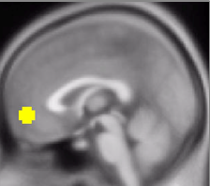
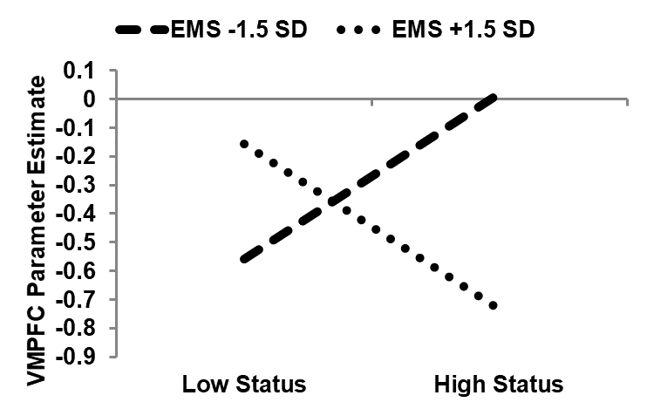
External motivation (EMS) predicts responses to status but not race
*
*
Status × EMS Interaction
b | SE | t(174) | p
-0.187 | 0.065 | -2.85 | .005
Mattan, Kubota, Dang, & Cloutier, 2018, SCAN
Notes:
What I found was that external motivation predicted responses to face status independent of face race.
(DESCRIBE AXES CLEARLY).
Looking first at the dashed line indicating low external motivation, we see the typical VMPFC increase for high status versus low status.
(CLICK) However, when we look at people with high external motivation, this relationship is reversed.
********************************************************************************************************
VMPFC, MNI [0,52,-6], 8-mm sphere
Both simples are p = .017.
RIGHT VS – not pictured, MNI [9,14,-6], 4-mm sphere
HS slope: p = .006
-1.5 effect: p = .012
+1.5 effect: p = .023
LEFT VS – not pictured, MNI [-9,8,-8], 4-mm sphere
LS slope: p = .035
-1.5 effect: p = .008
+1.5 effect: p = .020
RIGHT AMYGDALA – not pictured, MNI [24,-3,-21], 4-mm sphere
LS slope: p = .024
+1.5 effect: p = .029 (the -1.5 effect was non-significant)

Slide 25
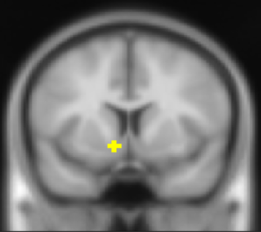
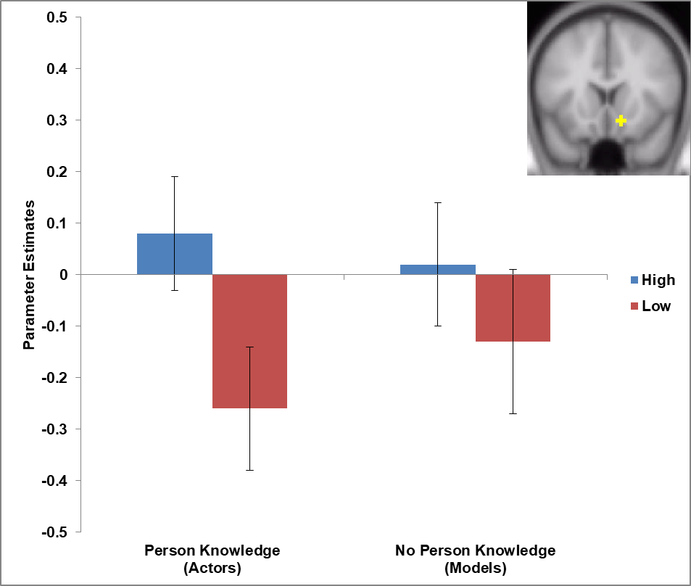
External motivation (EMS) predicts responses to status but not race
*
*
Status × EMS Interactions
*
Region | b | SE | t(174) | p
L. VS | -0.067 | 0.022 | -3.02 | .003
R. VS | -0.060 | 0.030 | -2.90 | .004
*
Mattan, Kubota, Dang, & Cloutier, 2018, SCAN
Notes:
I found the same motivation-related reversals in the left ventral striatum, which is plotted on top and in the right ventral striatum, which is plotted on bottom.
********************************************************************************************************
VMPFC – not pictured, MNI [0,52,-6], 8-mm sphere
Both simples are p = .017.
RIGHT VS, MNI [9,14,-6], 4-mm sphere
HS slope: p = .006
-1.5 effect: p = .012
+1.5 effect: p = .023
LEFT VS, MNI [-9,8,-8], 4-mm sphere
LS slope: p = .035
-1.5 effect: p = .008
+1.5 effect: p = .020
RIGHT AMYGDALA, MNI [24,-3,-21], 4-mm sphere
LS slope: p = .024
+1.5 effect: p = .029 (the -1.5 effect was non-significant)

Slide 26
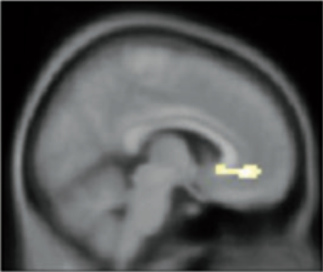
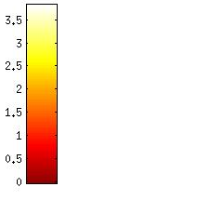
Reduced sensitivity in VMPFC to high (vs. low) status with increasing EMS
VMPFC Cluster (k = 56)
Peak Statistics
MNI [6, 39, -6]
t(59) = 3.81
p < .001
T-Test Statistic
Mattan, Kubota, Dang, & Cloutier, 2018, SCAN
Notes:
To supplement my a priori focus on the VMPFC and ventral striatum, I also conducted an exploratory whole-brain analysis. Lending greater confidence to the region of interest findings, a significant cluster emerged in the VMPFC showing reduced sensitivity to high versus low status as EMS scores increased.
*************************************************************************************************
*Although this cluster extends toward the nucleus accumbens, that region did not survive corrections for multiple comparisons.
Voxel threshold: p < .001, unc.
Extent threshold: k > 52 voxels (AlphaSim)

Slide 27
External motivation altered evaluative responses to status in the VMPFC
Low motivation
Typical positive evaluations for high vs. low status (Cloutier et al., 2012; Cloutier & Gyurovski, 2014)
High motivation
Reversal in positive evaluations of high status
Mattan, Kubota, Dang, & Cloutier, 2018, SCAN
Notes:
In summary, across analyses, I found that (READ TITLE)
(CLICK) Specifically, individuals who were low in external motivation showed the typical neural response to high (vs. low) status, thought to be associated with more positive evaluations of high-status individuals.
(CLICK) However, increasing external motivation reversed this typical pattern, suggesting that the value and/or salience of high status may be diminished in these individuals. Why might this be?
* One possible explanation comes from the idea that an externally motivated focus on something otherwise enjoyable dampens our enjoyment of that thing. So, in this experiment, participants’ externally motivated focus on status, presumably to avoid forming racist impressions, may have dampened the ordinarily positive associations that high status would elicit in the absence of that externally driven focus.
* Although intriguing as a potential explanation, I think more research is needed to dig into this possibility.
****************************************************
What about race?
Although interesting, the central findings were unexpected in that external motivation showed no relationship with responses to race, contrary to my predictions. Nonetheless, I think it’s implausible that high-EMS participants were insensitive to race.
What I think may have happened is that participants generally adopted a color-blind approach to impression formation (see Apfelbaum et al., 2012) in part because status may be a more socially acceptable attribute on which to form impressions of strangers. Plausible though this may be, it does not explain the interaction with perceived status.
And status?
Now, external motivation is thought to make whatever we do less enjoyable, perhaps even status-based evaluations.
* If so, the unusually low VMPFC response to high status in high-EMS participants may reflect an externally motivated focus on status. However, more research is needed to explore this intriguing possibility.
Alternative interpretations:
EMS (i.e., a race-related motivation) may generalize to other domains such as status
EMS is associated with an aversion to high status

Slide 28
How is EMS associated with coordination between brain regions involved in social cognition and prejudice regulation?
Mattan, Kubota, Li, Dang, & Cloutier, 2018, eNeuro
Notes:
To better understand the role of motivation in the neural response to status and race, I decided to follow up on these findings using a complementary analytic approach known as partial least squares analysis, which looks at coordinated activity throughout the brain rather than in focal regions of interest.
Using this method, I explored… (READ SLIDE)

Slide 29
Partial Least Squares Overview (PLS: McIntosh & Misic, 2013)
Mattan, Kubota, Li, Dang, & Cloutier, 2018, eNeuro
Notes:
As I just mentioned, I used an analytic approach known as partial least squares. I am aware that PLS is not a commonly used analysis method, so I want to give a high-level overview of what it does before I show you the results.
* For those who would like to read in depth about this approach, I recommend this paper by McIntosh and Misic from 2013 that nicely summarizes this approach and compares it to other exploratory analyses of functional connectivity.
* Like ICA/PCA, PLS is a data-driven exploratory technique that identifies patterns of covarying neural activity.
* Unlike ICA/PCA, PLS explicitly relates these patterns to the task design and/or individual differences.
* This is similar to canonical correlation analysis or canonical variate analysis in case anyone is familiar with those.
* Finally, unlike MVPA decoding techniques, PLS is more flexible in that it does not require splitting or folding the data into training and test datasets nor does it necessarily impose a specific contrast between conditions or a region of interest.

Slide 30
Partial Least Squares Overview (PLS: McIntosh & Misic, 2013)
Finds weighted patterns of co-activating voxels called Latent Variables (LVs).
LVs maximize explained covariance between two sets of data.
External motivation scores
Beta maps for each participant and condition
Mattan, Kubota, Li, Dang, & Cloutier, 2018, eNeuro
Notes:
To recap, PLS is an exploratory analysis that finds condition-specific weighted patterns of whole-brain coactivation called Latent Variables--LVs.
(CLICK) LVs are identified through a maximization of covariance explained between two sets of data. For example:
(CLICK) In this analysis, one set of data contained the participants’ external motivation scores.
* The other set of data contained each participant’s beta maps, which reflect mean activation levels within each of the four conditions contrasted against the task mean signal.
So, in this analysis, I used PLS to find patterns of voxels that increase or decrease in co-activation depending on the participant’s external motivation and the condition of the face they are viewing.
* These patterns can be subjected to statistical tests using permutation testing and bootstrapping. In the interest of time, I will skip those particulars, but I have a separate deck of slides that I could use to present on this at another time.

Slide 31
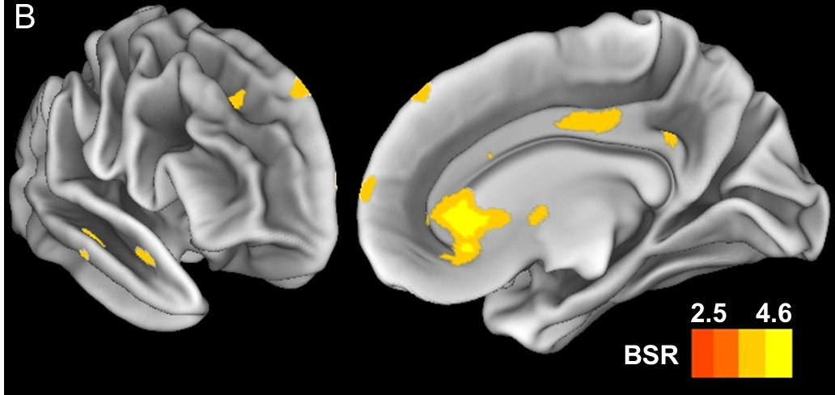
Increasing EMS associated with reduced co-activation in a network of regions supporting affect regulation and social cognition
DMPFC
rACC
Temporal Pole
Frontal Pole
Behavioral PLS revealed a significant 1st latent variable, p = 0.028
Crossblock covariance = 61.4%
n = 60
Mattan, Kubota, Li, Dang, & Cloutier, 2018, eNeuro
Notes:
When applying PLS to the impression formation task data, I found that (READ TITLE).
* Regions such as the rostral anterior cingulate in purple are involved in affect regulation and regions in green are involved in social cognition.
* I want to highlight that what we’re seeing here is a task-level effect; this reduced coordination between affect regulation and social cognition regions was similar regardless of the status and race of the face being processed.
(CLICK) Focusing for a moment on the rostral anterior cingulate cortex, this region has been associated in previous work with guilty feelings about one’s prejudice and implicit affect regulation.
*************************************************
This relationship was not substantially impacted when controlling for IMS (First LV: p = .033, explaining 61.61% of crossblock covariance). Due to the similarity between these two analyses and the limited IMS variance in our high-IMS sample, all reported results are without controlling for IMS. Nonetheless, any differences that emerged between these two analyses are indicated in Table 1.
* EEG work suggests that the rostral anterior cingulate may support monitoring for conflicts with external cues such as the potential that one is being monitored.
* This relationship was not substantially impacted when controlling for IMS (First LV: p = .033, explaining 61.61% of crossblock covariance). Due to the similarity between these two analyses and the limited IMS variance in our high-IMS sample, all reported results are without controlling for IMS. Nonetheless, any differences that emerged between these two analyses are indicated in Table 1.

Slide 32
What does this mean for evaluations?
Race-related discomfort
Poorer ability to regulate prejudice
Mattan, Kubota, Li, Dang, & Cloutier, 2018, eNeuro
Notes:
In summary, I found overall reduced communication between regions supporting affect regulation and social cognition during a task that involved forming impressions of people varying in status and race.
But what this might mean for social evaluations?
(CLICK) This disruption may be due to race-related discomfort* that is frequently reported by externally motivated people and that contributes to their poorer ability to regulate their own prejudice in interracial interactions.
**************************************************************************
As in previous work reporting multivariate analyses, response patterns differed from those we observed in our original region of interest analyses. Nonetheless, we note that the rACC region detected in the present PLS analysis overlaps partially with the VMPFC region I discussed in the first analysis. As a reminder, we found that EMS was associated with the neural responses to status in this region. The brain–behavior correlations from the previous slide are consistent with this picture (i.e., indicating numerically larger decreases in coactivation in the rACC for high-status than for low-status targets). Together, these findings suggest that external motivation may be associated with changes in both the participant’s overall approach to the task and the participant’s sensitivity to target attributes within the task (i.e., status level). Based on the partial anatomical overlap between the findings from these two complementary analyses, it will be important to more closely examine the degree to which rACC may play a unique role in supporting both task-general and target-specific effects of motivation.
*Supplemental analysis of a separate task failed to show a negative relationship between EMS and overall co-activation

Slide 33
Importance of a multi-analysis approach
VMPFC Analysis (task-specific)
EMS → reversal of pro-high-SES bias
Multivariate (task-general)
EMS → less neural coordination
Mattan, Kubota, Li, Dang, & Cloutier, 2018, eNeuro
Notes:
Stepping back now to consider findings from both fMRI analyses I presented, I want to highlight how the multiple analysis approaches I used complement one another.
(CLICK) The univariate analysis I presented first showed that external motivation to respond without racial prejudice was tied to a task-specific reversal of evaluative responses to high SES that are typically observed in neuroimaging work.
(CLICK) In the multivariate PLS analysis I just showed you, EMS was associated with a task-general disruption in regions involved in social cognitive control, something that univariate analyses are not able to reveal.
* Taken together, these results suggest that external motivation to respond without racial prejudice may predict both task-general and task-specific responses to perceived status when race is salient. It will be important to consider both effects in future research on external motivation in interracial interactions.
**************************************************************************
As in previous work reporting multivariate analyses, response patterns differed from those we observed in our original region of interest analyses. Nonetheless, we note that the rACC region detected in the present PLS analysis overlaps partially with the VMPFC region I discussed in the first analysis. As a reminder, we found that EMS was associated with the neural responses to status in this region. The brain–behavior correlations from the previous slide are consistent with this picture (i.e., indicating numerically larger decreases in coactivation in the rACC for high-status than for low-status targets). Together, these findings suggest that external motivation may be associated with changes in both the participant’s overall approach to the task and the participant’s sensitivity to target attributes within the task (i.e., status level). Based on the partial anatomical overlap between the findings from these two complementary analyses, it will be important to more closely examine the degree to which rACC may play a unique role in supporting both task-general and target-specific effects of motivation.
*Supplemental analysis of a separate task failed to show a negative relationship between EMS and overall co-activation

Slide 34
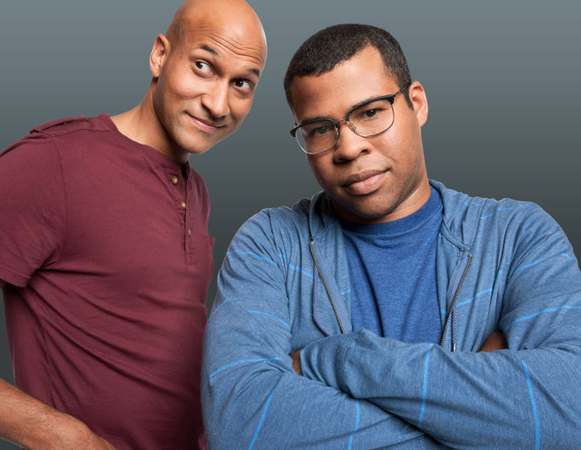
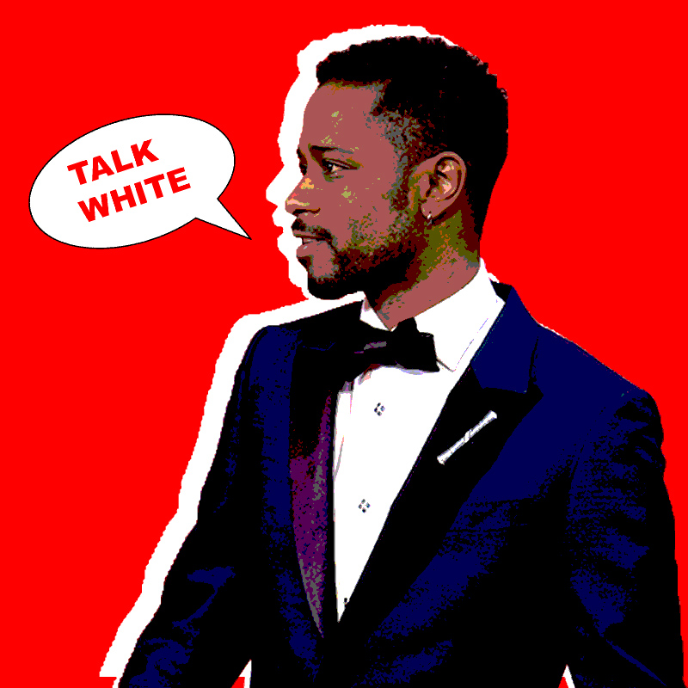
What could this mean for interracial interactions?
Suspicions of high-EMS White people (LaCosse et al., 2015)
Notes:
Since I ran this impression formation study a couple of years ago, I have continued to ask [READ TITLE].
(CLICK) For starters, research suggests that racialized people are good at figuring out if White people’s motivations to respond without prejudice are external or internal.
* In cases where it’s apparent that the White person’s avoidance of racism is externally motivated (i.e., that it’s not sincere), the racialized people who interact with that White person may feel the pressure to code switch. Code switching refers to the process of altering how one speaks or acts depending on the context.
(CLICK) The term was popularized a few years ago by comedic duo Key and Peele.
(CLICK) However, behind their comedy is the unpleasant reality for racialized people who can feel pressured to change how they act or speak in a way that does not feel authentic when they are in white-dominated settings. In this country, white-dominated spaces are nearly everywhere, meaning that this is a burden and chronic stressor for many people of color.

Slide 35
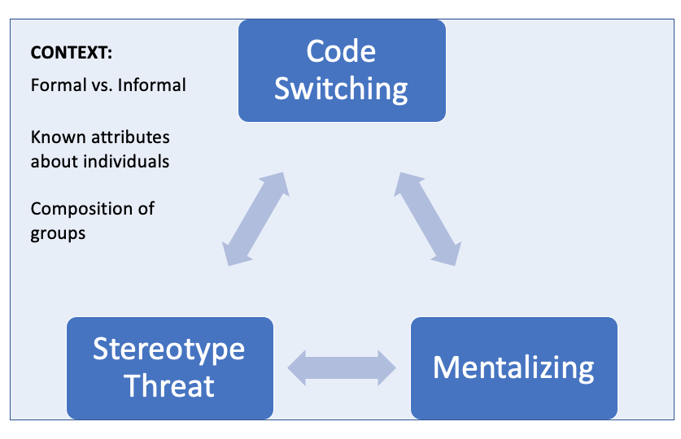
Code switching
Johnson, Mattan, Lauharatanahirun, & Falk, under review
Notes:
A PhD student I have been mentoring is exploring how doubts about the motives of White people can trigger stereotype threat and prompt racialized people to engage in code switching.
We currently have a theory piece on this work under review.
In a future experiment, we plan to use fMRI to test how the effects of stereotype threat on mentalizing prior to and during interracial contact may depend on the frequency with which one engages in code switching.
Although it is just getting started, this line of work has the potential to inform interventions that ease the burdens of code switching on racialized people and thus promote more inclusive organizations.
Building on the literature on racial inequities in stress and health more broadly, I am interested in pursuing the implications of this work for the mental and physical well-being of racialized people.

Slide 36
Gender and social status
Status acquisition is linked to masculine roles (Eagly, 2009) and identity (Vandello et al., 2008)
Men show greater status bias on the IAT (Mattan & Cloutier, 2020, Royal Society Open Science)
Men show greater neural sensitivity to status (Barth*, Mattan*, et al., 2020, Scientific Reports)
* Shared first author
Notes:
Extending my social neuroscience approach to consider how status intersects with other social identities, I have recently done some work on how one’s gender shapes spontaneous evaluative responses to perceived status. This work is motivated by the literature on social determinants of gender differences.
(CLICK) For example, gender roles theory and the precarious manhood hypothesis both predict that status acquisition is important to masculine roles and identity, which may enhance men’s positive associations with high status in many contexts. In two studies, I found evidence that supports this prediction.
(CLICK) In a registered report based on a national sample from Project Implicit, I found that men showed greater pro-rich/anti-poor bias than did women.
(CLICK) Consistent with this report, I also found that men show greater neural sensitivity to status. I’m going to take a moment to go over some of the findings from this fMRI study.

Slide 37
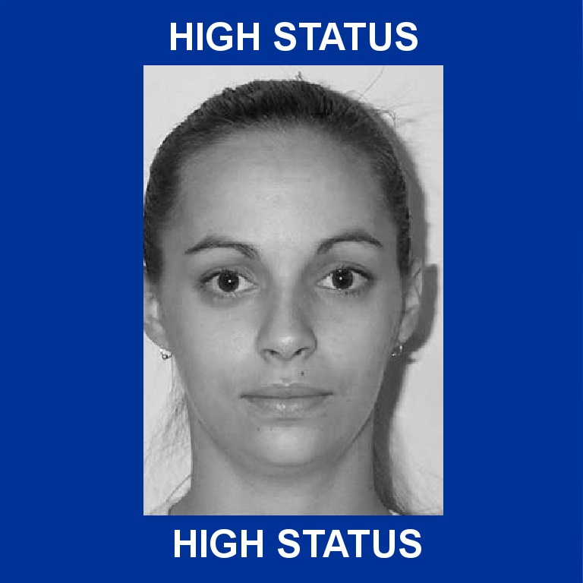
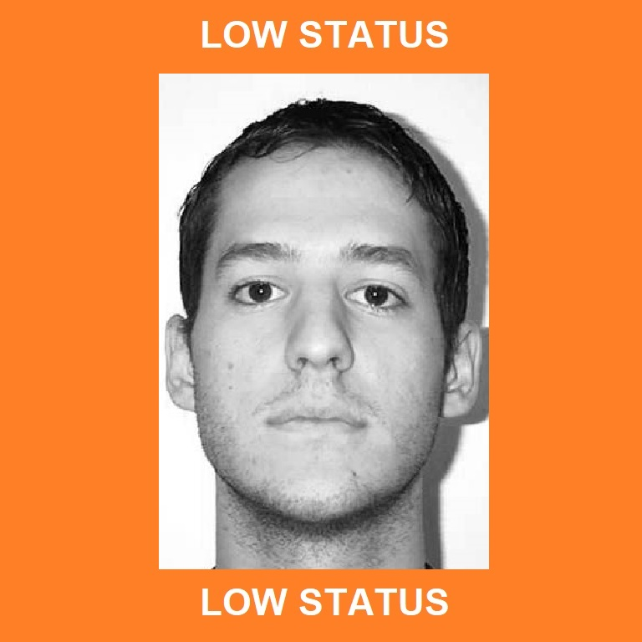
Impression formation study
fMRI impression formation task:
* Shared first author
Barth*, Mattan*, Dang, & Cloutier, 2018, Scientific Reports
Notes:
The procedure for this study was very similar to the one I presented for the last impression formation study. Each trial consisted of a woman or a man framed by a colored background, which was indicative of their socioeconomic status.
* Just like for the last study, participants quickly formed an impression of each person, pressing one key with each index finger to indicate that they had formed their impression.

Slide 38
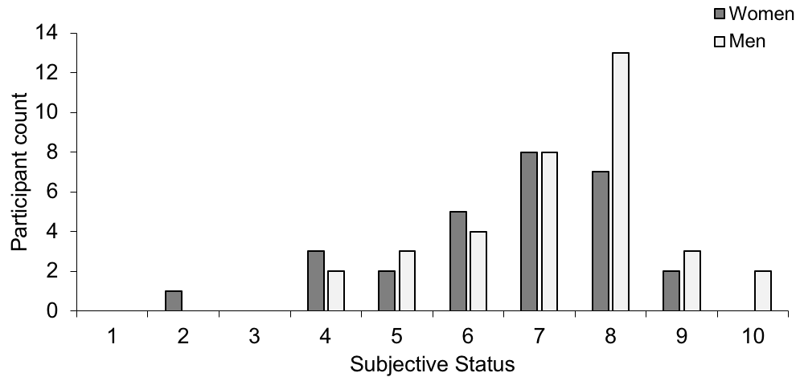
Sample and analyses
Sample characteristics
28 women, 37 men
White non-Hispanic
Chicago area
18-35 years old
Examined relationship between participant gender and neural responses to status/gender
* Shared first author
Barth*, Mattan*, Dang, & Cloutier, 2018, Scientific Reports
Notes:
For this study, we recruited 28 White women and 38 White men between 18 and 35 years old from the Chicago area.
(CLICK) Just like in the last study, these participants were high in subjective status. Although men (plotted in White) appear to be slightly higher in subjective status than women (plotted in gray), this difference was not significant.
(CLICK) In this study, I looked at the relationship between participant gender and average responses to the perceived gender and status of faces in the VMPFC and ventral striatum, which reflect value and reward.
*****************************************************
Although women trended lower in subjective status (M = 6.571, SD = 1.665) than men (M = 7.257, SD = 1.482), this difference was non-significant, t_{Welch}(56.489) = -1.387, p = .171 (see Figure SF1). A chi-square test also indicated that the representation of women and men across the different levels of subjective status was not significantly different, p = .66.

Slide 39
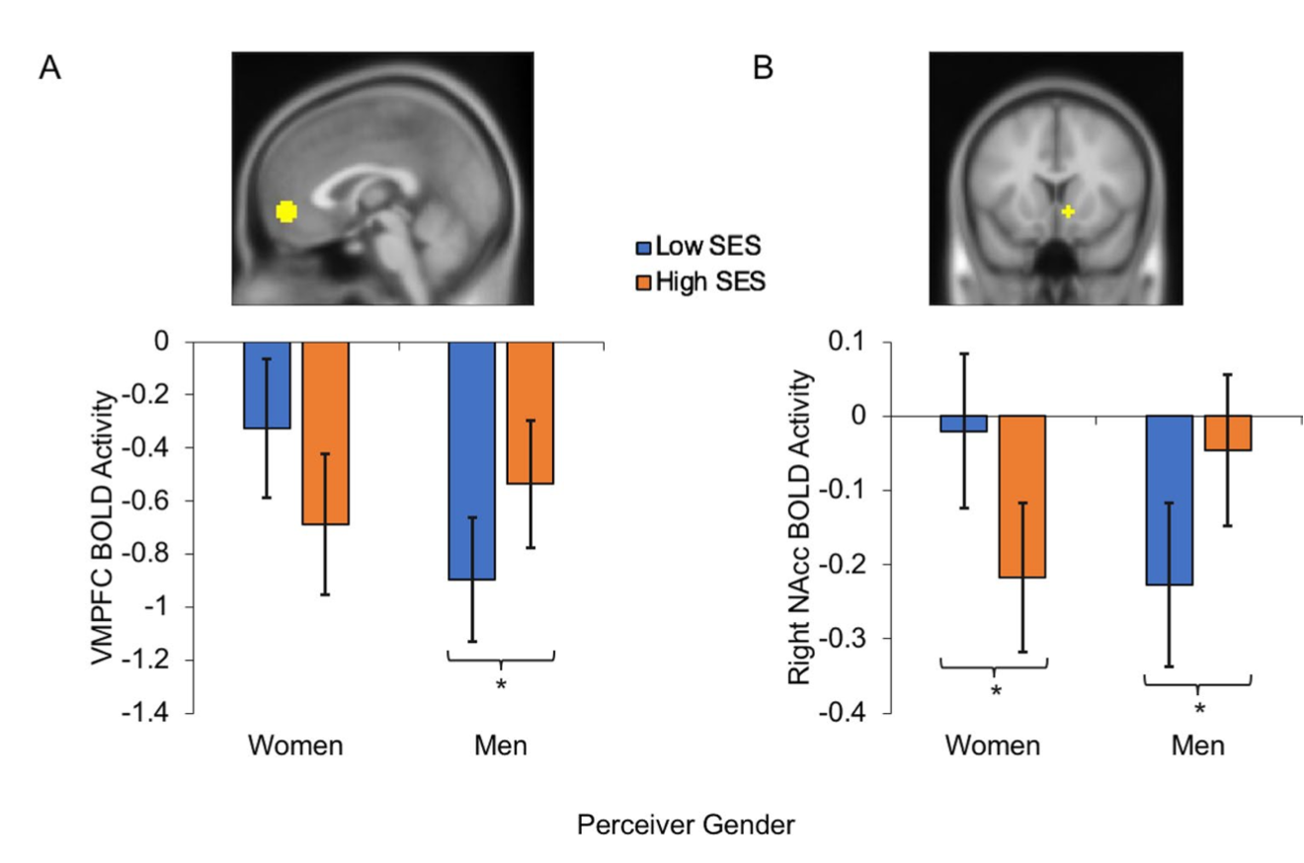
Men showed larger neural responses for high status in the VMPFC and VS
* Shared first author
Barth*, Mattan*, Dang, & Cloutier, 2018, Scientific Reports
Notes:
Region of interest analyses revealed that… (READ TITLE)
* Looking first at the VMPFC results, (EXPLAIN AXES—collapsed across target gender).
* You can see that men showed a greater response to high status compared to low status.
(CLICK) Women appeared to show the opposite status effect, but this difference was non-significant.
(CLICK) In the ventral striatum, you can see a similar pattern.
* So these results suggest that men may be valuing high status more positively than women (consistent with my IAT findings). On the other hand women may evaluate low status more positively than men.
* Although these gender differences within the regions of interest are interesting, I went a step further to see if women and men fundamentally differed in how they recruited whole-brain networks to evaluate high status assuming a similar level of pro-high-status bias in the VMPFC.

Slide 40
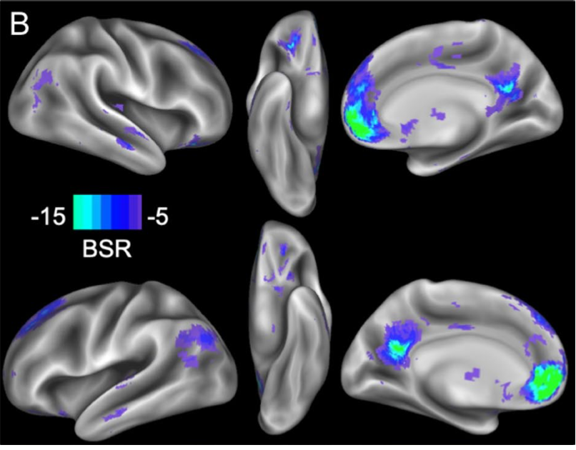
Greater VMPFC-PCC coactivation with larger status effects in the VMPFC
* Shared first author
Barth*, Mattan*, Dang, & Cloutier, 2018, Scientific Reports
Notes:
Using a variant of PLS known as seed PLS, I looked at how whole-brain co-activation patterns to status increased or decreased depending on the magnitude of the pro-high-status effect participants showed in the VMPFC.
* Results showed (READ TITLE).
* This effect did not vary by participant gender or perceived gender, suggesting that both women and men can recruit a similar set of brain regions when forming evaluations of high-status people if they are showing a pro-high-status bias in the VMPFC.

Slide 41
Summary
Men showed greater pro-high-status bias
Supports social determinants of gender
Constrains mate selection theory
Genders did not fundamentally differ in the functional network supporting status-based evaluation
* Shared first author
Barth*, Mattan*, Dang, & Cloutier, 2018, Scientific Reports
Notes:
Taken together, the findings from this fMRI study on gender differences in status-based evaluation suggest that, at least in this sample, men compared to women showed more evidence of spontaneous positive evaluations of high status when forming impressions.
(CLICK) This effect is consistent with work on the social determinants of gender, which argues that men are socialized through gender roles and cultural notions of masculinity to value high status positively.
(CLICK) Additionally, these findings also put an important constraint on generalizations from mate selection theory arguing that women highly value status.
(CLICK) One final takeaway here is that women and men did not fundamentally differ in how they recruit whole-brain networks to evaluate high status.
* To the extent that they showed similar VMPFC responses to high status versus low status, both women and men recruited a similar set of brain regions to evaluate status during impression formation.

Slide 42
Overview
What neural processes support impression formation based on perceived status and race?
Can we isolate neural signatures of self-relevance and valence to predict health message effectiveness?
Future directions
Notes:
At this point, I’m going to transition to the second part of my talk. Having covered some of my social neuroscience work on the consequences of perceived social status for the way we evaluate people, I’m now going to focus on some of my recent health neuroscience work that looks at how neural responses to self-relevance and valence can predict the effectiveness of health messaging that promotes physical activity.
* In this health neuroscience part of my talk, I will be moving away from social status to focus on the neural representation of self-relevance and valence.
* I want to share this work because it provides a good example of how I use the brain-as-predictor approach, which I plan to use more frequently in other work going forward. After covering this study on health messaging, I will take some time to discuss applications of this approach to ongoing and future studies that focus more directly on social status and health disparities.

Slide 43
Aims: Self-relevance and valence
Theoretical (Wagner et al., 2018)
Can we meaningfully differentiate self-relevance and valence in the brain?
Application (Berkman & Falk, 2013)
Brain as predictor
Notes:
As I mentioned a moment ago, this next study focuses on how the brain represents self-relevance and valence.
* Specifically, I wanted to find a data-driven way to leverage the latent differences between how the brain processes these dimensions.
(CLICK) From a theoretical perspective, it would be informative if there were a way to identify patterns of neural activity that meaningfully differentiate self-relevance and valence, especially in light of existing machine-learning work that suggests this can be difficult.
(CLICK) From an applied perspective, identifiable neural patterns of self-relevance and valence would be the first step toward using these patterns to predict real-world outcomes.
* For example, people’s receptivity and adherence to health messages may depend on whether their brains’ responses to those messages reflects a pattern typical of self-relevance but not valence or vice versa.
*********************************************
This is particularly important when it comes to measuring the effectiveness of messages because perceptions of message relevance (Doré et al., 2019) and message valence (Pegors et al., 2017) may distinctively affect message receptivity and adherence.

Slide 44
Analytic approach
Step 1: Identify brain maps that differentiate relevance and valence judgments
Step 2: Test if maps predict receptivity to health messaging
Mattan, Cooper, Scholz, Kang, & Falk, in preparation
Notes:
In order to address the aims on the last slide, I implemented a two-step analysis approach.
(CLICK) First, I used the PLS analysis that I mentioned in my social neuroscience work to generate maps of neural co-activation that differentiated judgments about self-relevance from judgments about valence.
(CLICK) After identifying these maps, I then tested whether trial-wise similarity to these maps would predict receptivity to health messages designed to promote physical activity in a community sample of sedentary adults.
*************************************************
Some examples of tests that I ran:
Whether a trait is high in pre-rated valence and/or relevance
Self-relevance of health messaging and downstream effects on health behavior

Slide 45
Sample (see Kang et al., 2018)
Participants
220 adults
Philadelphia area
96 Black, 86 White, 16 Asian, 9 Non-White Hispanic, 13 Other
Age: M = 34, SD = 12
Inclusion criteria
< 200 min. of physical activity per week
BMI > 25
Mattan, Cooper, Scholz, Kang, & Falk, in preparation
Notes:
To test these predictions, I used a large existing fMRI dataset containing data from a diverse sample of 220 adults from the Philadelphia area.
(CLICK) Importantly, participants in this study were relatively sedentary at the start of the study, as inferred through low self-reported physical activity and a body-mass index of greater than 25.
*****************************************************
In order to target individuals who were at health risk, the eligibility criteria included: 1) self-reporting engaging in less than 200 minutes of walking, moderate, and vigorous physical activity throughout the week prior to the screening (using a short form International Physical Activity Questionnaire: Craig et al., 2003), and 2) have a BMI over 25, derived from self-reported height and weight.

Slide 46
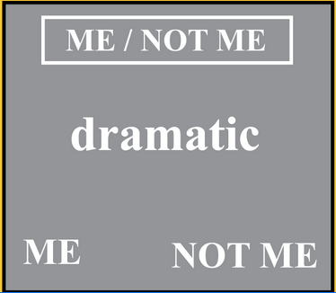
Words Task (n=163)
Explicit judgments about traits
Upper vs. Lowercase
Me vs. Not Me
Good vs. Bad
Mattan, Cooper, Scholz, Kang, & Falk, in preparation
Notes:
As part of this larger project, a subset of participants completed an fMRI task involving judgments about trait words.
This words task was divided into blocks corresponding to three different kinds of judgments.
(CLICK) In the control blocks, participants indicated whether each trial’s word was presented in uppercase or lower case.
(CLICK) In the relevance blocks…
(CLICK) In the valence blocks…
*************************************************************
they had rated for self-relevance and valence in an earlier session prior to coming in for their scan.
Jobs Task (n=174): “Is being [trait] typical of [job]?”

Slide 47
Partial least squares analyses
Generated a pair of co-activation maps:
Valence (vs. control) judgments
Self-relevance (vs. control) judgments
Mattan, Cooper, Scholz, Kang, & Falk, in preparation
Notes:
Using data from the words task, I conducted separate partial least squares analyses to generate a pair of brain maps reflecting greater co-activation for judgments of self-relevance (vs. control) and judgments of valence (vs. control).
(CLICK) So in one analysis, I identified patterns of voxels that increased or decreased in co-activation depending on whether participants were making valence judgments or control judgments.
(CLICK) In the other analysis, I identified patterns of voxels that increased or decreased in co-activation depending on whether participants were making relevance judgments or control judgments.
************************************************
As a reminder, PLS is an exploratory analysis that finds condition-specific weighted patterns of whole-brain coactivation called Latent Variables--LVs.

Slide 48
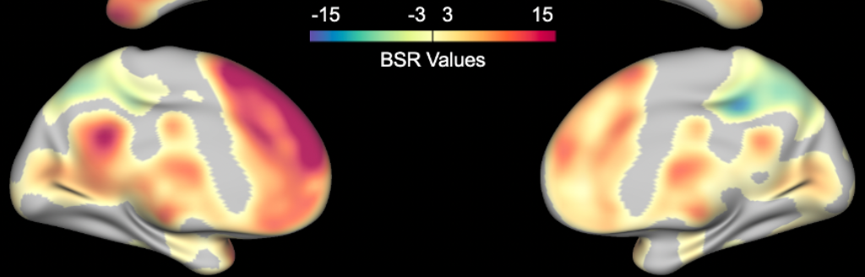
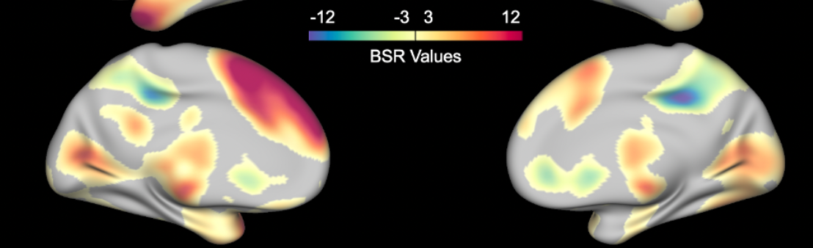
Relevance and valence judgments were associated with distinct VMPFC co-activation
Relevance Judgments vs. Case Judgments
LV (p < .001)
Valence Judgments vs. Case Judgments
LV (p < .001)
Mattan, Cooper, Scholz, Kang, & Falk, in preparation
Notes:
Results from these analyses revealed that… (READ TITLE).
(CLICK) Starting first with the analysis of relevance judgments, you can see that the VMPFC (shown in crosshairs) co-activated positively with other structures in the cortical midline, which are depicted in warm colors.
(CLICK) In contrast, the analysis of valence judgments shows that the VMPFC negatively co-activated with the cortical midline.
* Despite the apparent difference in how the VMPFC co-activated with the rest of the brain, you can see that valence and relevance maps are otherwise very similar.
In fact, when I computed dot product similarity for each of these two maps with trial-wise beta maps from an independent task, the correlation between the resulting similarity scores was greater than .9.
This is consistent with machine learning work that shows you can classify self-relevance above chance on a classifier that is trained on valence.
_____________________________________________
/data00/projects/physact2/scripts/PLS/Plotting_and_Extracting_Latent_Variables_from_Words_PLS_051420.ipynb
A direct contrast of relevance and valence (contrasting out control) also revealed this dissociation in the VMPFC
data00/data00/projects/physact2/scripts/PLS/Plotting_and_Extracting_Latent_Variables_from_Words_PLS_021720.ipynb

Slide 49
Analytic approach
Step 1: Identify brain maps that differentiate relevance and valence judgments
Step 2: Test if maps predict receptivity to health messaging
Mattan, Cooper, Scholz, Kang, & Falk, in preparation
Notes:
So, based on the findings I just showed you, it is possible to differentiate relevance and valence in the VMPFC by looking at how the VMPFC is co-activating with the rest of the brain as participants engage in judgments about trait relevance and trait valence.
* As a next step, I looked at whether I could leverage this differentiation to predict participants’ receptivity to health messages that were presented in a separate fMRI task.
*************************************************
Some examples of tests that I ran:
Whether a trait is high in pre-rated valence and/or relevance
Self-relevance of health messaging and downstream effects on health behavior

Slide 50
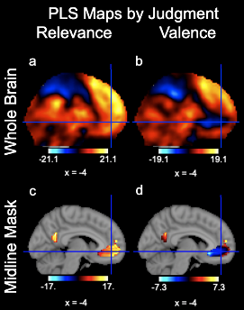
Masking the cortical midline
Mattan, Cooper, Scholz, Kang, & Falk, in preparation
Notes:
To better understand how these distinct patterns for relevance and valence might predict responses to health messaging, I created a cortical midline mask defined through subtraction as the voxels showing the largest difference between the self-relevance and valence PLS maps.
It wasn’t as easy to see before, but here you can see that the largest differences were in the VMPFC and the posterior cingulate cortex.
In the analyses I’m going to be showing you next, I will be focusing on neural pattern similarity to the masked midline maps for self-relevance and for valence.
*****************************************
The threshold for difference was greater that 9.5 BSRs. This resulted in two clusters with at least 30 voxels in each.
I will also account for similarity to areas of the brain captured by the inverse of this mask by including these similarity scores as a covariate.

Slide 51
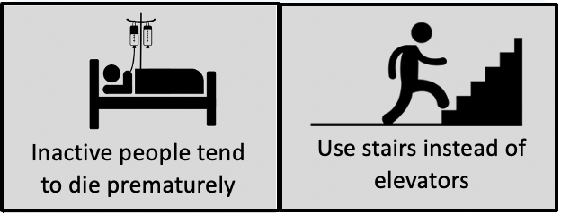
Health Messages Task (n=170)
Listen to each message and rate message relevance
activity-related
non-active control
Mattan, Cooper, Scholz, Kang, & Falk, in preparation
Notes:
For this next set of analyses, I used fMRI task data from a subset of project participants who were scanned while listening to health-related messages that promote physical activity.
* While in the scanner, participants listened to these messages. Immediately after listening to each message, they rated it for its perceived self-relevance.
(CLICK) Messages came in two primary types: Activity-related messages were designed to promote being more active, which was especially relevant to the sedentary lifestyles of these participants.
(CLICK) Control messages gave advice in areas of life other than physical activity such as parking or paying taxes.
***********************************************
Message type: how to, risky consequences, why do it

Slide 52
Predicting message receptivity
Separate GLM for each health message (LSS approach: Mumford et al., 2012)
IV: Similarity between level-1 and PLS maps (nltools: Chang, 2018)
DVs
In-scan perceived message relevance
Post-scan message agreement
Mattan, Cooper, Scholz, Kang, & Falk, in preparation
Notes:
Using the health messages task data, I computed a separate GLM for each participant and message.
(CLICK) I then computed dot product similarity between each of these level-1 maps and each of the two PLS-derived co-activation maps. This means I ended up with similarity scores for each combination of participant, message, and PLS map.
* I then used these similarity scores as independent variables in separate models to predict health message receptivity.
(CLICK) Dependent variables for health message sensitivity included perceived message relevance ratings provided during scanning and participants’ post-scan message agreement.
(CLICK) So, let’s start first with message relevance.
***********************************************
Least Squares Separate (LSS): In other words, I modeled the trial-specific message on one regressor, all other messages on a second regressor, and all message response windows on a third regressor.
* I want to remind you that I computed similarity scores within the cortical midline mask I mentioned a moment ago, but I also computed similarity scores to areas of the brain captured by the inverse of this map in order to account for any variance there.

Slide 53
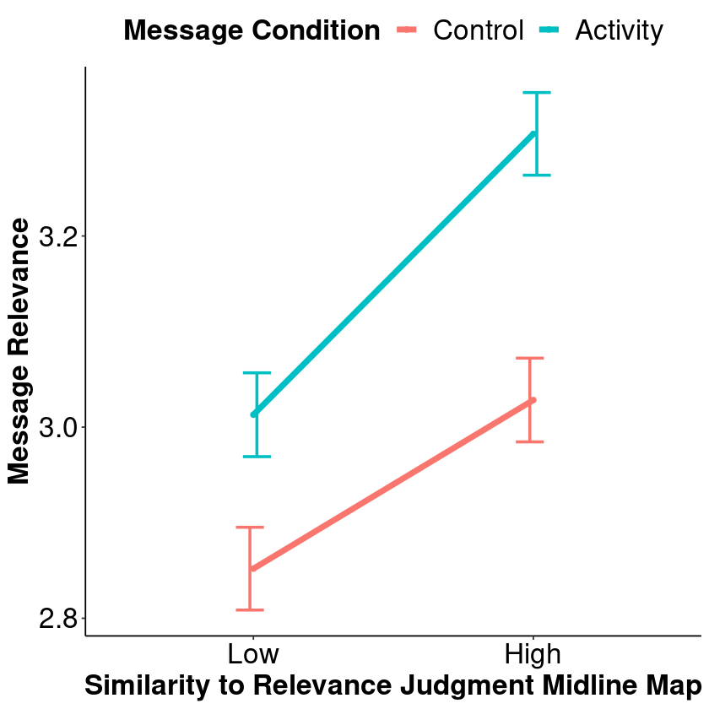
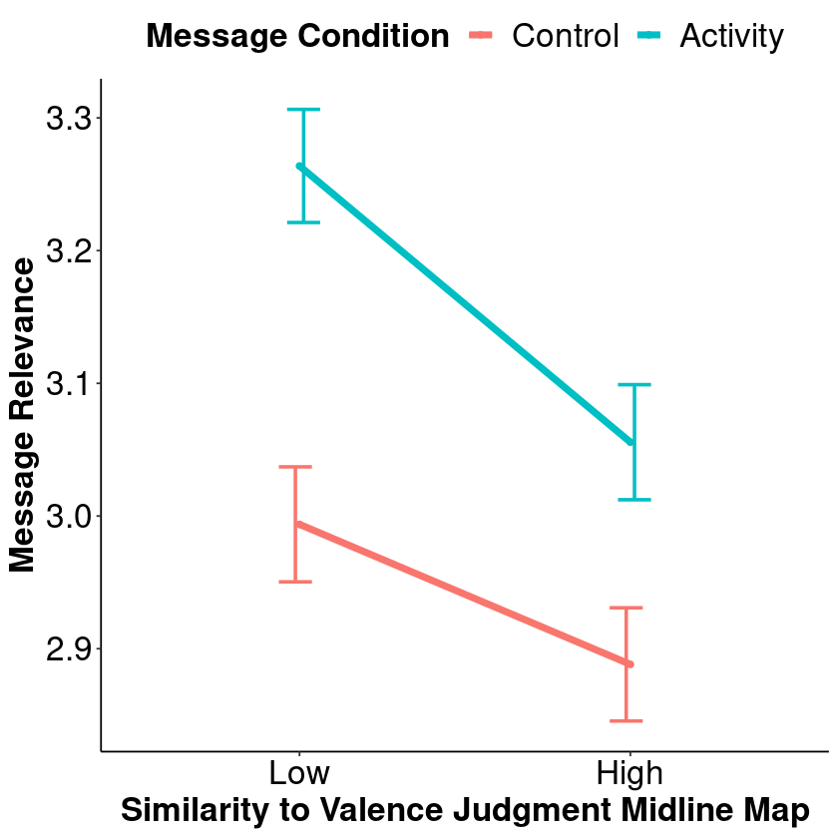
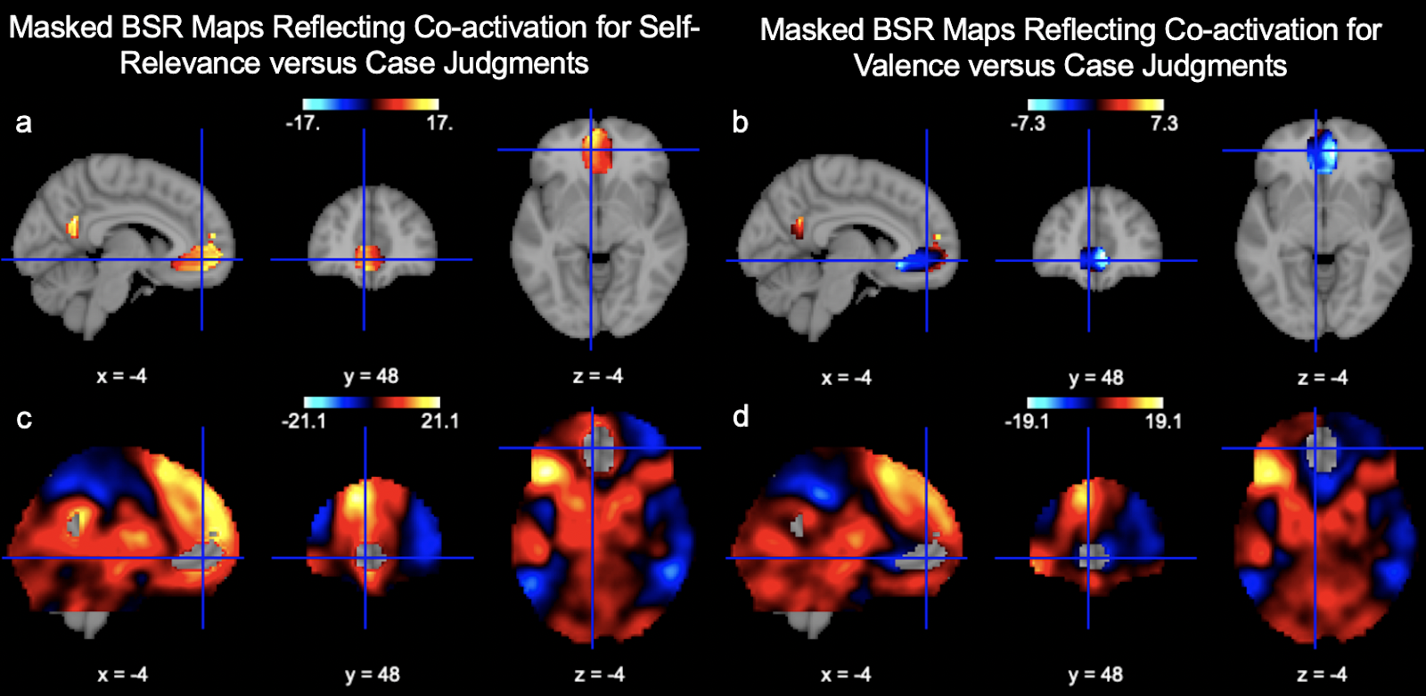
Relevance and valence maps differ in predicting perceived message relevance
Mattan, Cooper, Scholz, Kang, & Falk, in preparation
Notes:
Results showed that similarity to the relevance and valence judgment maps had opposing effects on perceived message relevance.
I will first show how similarity to the relevance judgment map affected perceived message relevance. (DESCRIBE AXES AND LEGEND)
(CLICK) For control condition messages, I found that similarity to the relevance map predicted significantly greater perceived message relevance.
(CLICK) For activity condition messages, I found that the simple effect of similarity was even more pronounced.
(CLICK) When looking at similarity to the valence judgment map, effects ran in the opposite direction. So greater similarity to the valence midline map predicted less perceived message relevance, especially for messages about physical activity.
* Taken together, these results show that greater similarity to the relevance judgment pattern predicted greater perceived message relevance. In contrast, similarity to the valence judgment pattern predicted less perceived message relevance.
*********************************************************
All simple effects on this slide are significant, p < .001
Relevance: Midline ✕ Condition interaction, p = .005
Valence: Midline ✕ Condition interaction, p = .020
Although I am not showing it here, the pattern for valence similarity was consistent with the effect of similarity to the pattern of brain activity outside of the cortical midline mask.

Slide 54
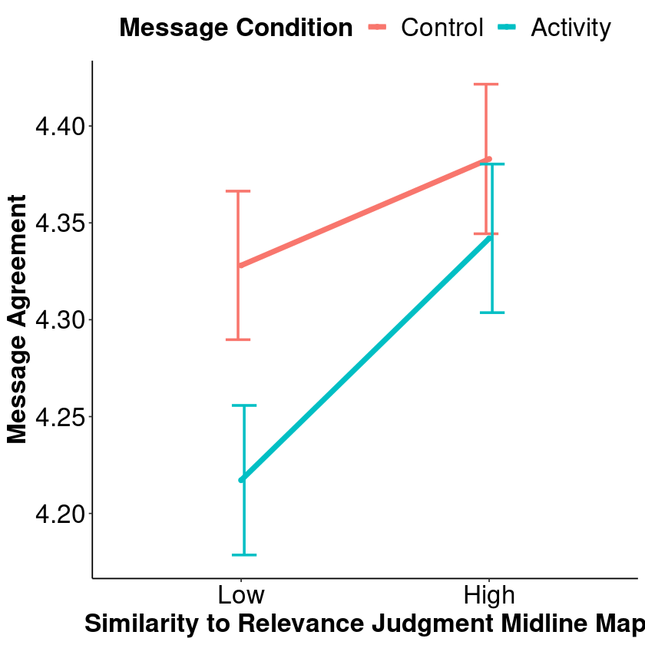

Relevance and valence maps differ in predicting message agreement
Mattan, Cooper, Scholz, Kang, & Falk, in preparation
Notes:
Next, I looked at how the relevance and valence judgment patterns predicted post-scan message agreement.
(CLICK) Results showed that similarity to the relevance and valence judgment maps had opposing effects on message agreement.
(CLICK) Let’s look first at how similarity to the relevance judgment map affected message agreement. (DESCRIBE AXES AND LEGEND)
(CLICK) For control condition messages, I found that similarity to the relevance map predicted significantly more message agreement.
(CLICK) For activity condition messages, I found that the simple effect of similarity was even more pronounced.
(CLICK) When looking at similarity to the valence judgment map, effects again ran in the opposite direction. So greater similarity to the valence map predicted less message agreement, but this time only for messages about physical activity.
*********************************************************
All simple effects for Relevance were significant except for the effect of message condition at high similarity, p < .05
Relevance: Midline ✕ Condition interaction, p = .008.
Only the simple slope of similarity for the activity condition and the simple effect of activity at low similarity were significant for Valence, p ≤ .001.
Valence: Midline ✕ Condition interaction, p = .012.
Although I am not showing it here, the pattern for valence similarity was again consistent with the effect of similarity to the pattern of brain activity outside of the cortical midline mask.

Slide 55
Summary
Similarity to patterns reflecting judgments about relevance/valence showed opposing effects on message effectiveness
Relevance → increased relevance/agreement
Valence → decreased relevance/agreement
Mattan, Cooper, Scholz, Kang, & Falk, in preparation
Notes:
In summary, the results from this second analysis suggested that similarity to midline patterns reflecting judgments about relevance and valence showed opposing effects in predicting the effectiveness of the messages viewed by participants, especially those that are most relevant to their sedentary health status.
(CLICK) Whereas similarity to the relevance pattern predicted greater perceived message relevance and post-scan message agreement,
(CLICK) similarity to the valence pattern was associated with less perceived message relevance and agreement.
*****************************
Similarity to the pattern in the rest of the brain mimicked results of the valence midline pattern.

Slide 56
Summary
Similarity to patterns reflecting judgments about relevance/valence showed opposing effects on message effectiveness
Relevance → increased relevance/agreement
Valence → decreased relevance/agreement
Mattan, Cooper, Scholz, Kang, & Falk, in preparation
Notes:
Taken together, these findings suggest that trial-wise similarity to a neural pattern tracking deliberation about the valence of information was associated with reduced message effectiveness.
As a reminder, I want to highlight that this valence pattern was not tied to positive or negative responses per se, but rather to deliberation about the valence of trait adjectives in the words task.
The fact that similarity to this valence judgment pattern reduced message receptivity suggests possible defensive rumination or counterarguing.
* In contrast, increasing co-activation between the VMPFC and posterior cingulate that appears to occur when deliberating about self-relevance may serve as a neural signature of message effectiveness in future research.

Slide 57

Aims: Self-relevance and valence
Theoretical (Wagner et al., 2018)
Can we meaningfully differentiate self-relevance and valence in the brain?
Application (Berkman & Falk, 2013)
Brain as predictor
Mattan, Cooper, Scholz, Kang, & Falk, in preparation
Notes:
Returning to the aims I introduced at the start of this study, I want to highlight a couple more takeaways and a future direction.
At the start of this study, I wanted to know if it was possible to meaningfully differentiate between neural signatures of self-relevance and valence in the brain.
(CLICK) Results indicated that it is indeed possible to differentiate relevance and valence in the VMPFC and posterior cingulate by looking at how these regions co-activate with one another and with the rest of the brain as participants engage in judgments about trait relevance and trait valence.
* Having identified co-activation patterns that differentiated relevance from valence, I next wanted to see if I could predict message effectiveness based on participants’ patterns of brain activity in response to each message.
(CLICK) As I discussed in the last slide, these patterns of neural activity ultimately predicted key metrics of message effectiveness.

Slide 58



Future directions
Berkman & Falk, 2013
Notes:
Now, although these findings are an exciting start, part of the idea behind the behind the brain as a predictor is that we can predict real-world outcomes from neural activity.
(CLICK) In the next phase of this project, I plan to see whether the patterns I generated using PLS may also predict increases in physical activity as measured by accelerometers.
(CLICK) Tying into my ongoing work on smoking which I didn’t get to cover today, I plan to examine whether expression of these patterns when viewing anti-tobacco messaging relates to the effectiveness of a mobile-based intervention that delivers encouragement to quit smoking at targeted times and locations.
(CLICK) Finally, tying back to my earlier work on status- and race-based evaluations, I want to use this approach to measure neural reactivity to messages that challenge classism and racism, with the ultimate goal of predicting openness to and the success of intergroup contact.

Slide 59
Overview
What neural processes support impression formation based on perceived status and race?
Can we isolate neural signatures of self-relevance and valence to predict health message effectiveness?
Future directions
Notes:
In the final minutes of my talk, I want to summarize some of the work I covered today and then outline the broader contours of my research program going forward.
(CLICK) I started off discussing some of my social neuroscience work on the consequences of perceived status for how we evaluate people, focusing in particular on individual differences in gender and motivation to regulate prejudice.
(CLICK) Next, I covered some of my health neuroscience work how we can differentiate self-relevance and valence in patterns of brain responses within the VMPFC and posterior cingulate. Applying the brain-as-predictor model, I was able to use these patterns to predict the effectiveness of health messaging in a large community sample.
* I also highlighted some ideas I have for applying this brain-as-predictor approach in future work on socioeconomic disparities in well-being.
(CLICK) To wrap things up, I am going to give you a high-level view of my research program for the coming years.

Slide 60
Neuroscience of status and health
Social Psychology & Neuroscience
Implicit prejudice
Impression formation
Decision making
Social Determinants
of Health Disparities
Race-related stressors
Poverty and smoking
Status and immunity
Health Psychology & Neuroscience
Physical activity
Tobacco retailers
COVID-19 messaging
Notes:
Returning to a simplified version of the Venn diagram from the start of my talk, you can see that I covered work from the social and health neuroscience branches of my research.
(CLICK) Going forward, my plan is to wed these two approaches by focusing on the social determinants of health disparities, which aligns with ongoing health disparities research of LSU faculty at Pennington.
* I have already begun this work, but I want to give you a closer look at my thinking in this area before I finish up.

Slide 61
Social determinants of health
Structural
Disparities
Mental Health
Physical Health
Morbidity/Mortality
etc.
Individual
Interpersonal
Notes:
My research program going forward will focus on three domains that research suggests make causal contributions to socioeconomic disparities in mental and physical health, and ultimately in morbidity and mortality.
(CLICK) At the structural level, I plan to look at negative influences of geolocation-based exposure to poverty and racial segregation.
(CLICK) At the individual level, I plan to look at factors like individual differences in social rank, cognition, dispositions, and neurobiological reactivity to stressors.
(CLICK) I will also focus on interpersonal influences on health, primarily through the mechanisms of social comparison and stereotype threat that permeate our everyday experience in the multiple intersecting hierarchies that we inhabit.
(CLICK) Importantly, these domains can interact in their effects on health behaviors. This is something that will be a key feature of my future research and efforts to address health disparities through intervention work.
I look forward to discussing these and other ideas in the Q&A and in our remaining one-on-one meetings today.

Slide 62







Acknowledgements
Email: brad.mattan@gmail.com
Twitter: @BradleyMattan
Emily Falk
Jennifer Kubota
Jasmin Cloutier
Kimberly Quinn
Pia Rotshtein
Collaborators
CN Lab (U Penn)
DDS Group (U Penn)
IFSN Lab (U Delaware)
mHealth Lab (NYU)
Michael Fichman (U Penn)
Notes:
And with that, I would like to conclude by recognizing my brilliant collaborators and others who have helped make my work possible.
I look forward to any questions you may have. Thank you very much!

